Slide 1
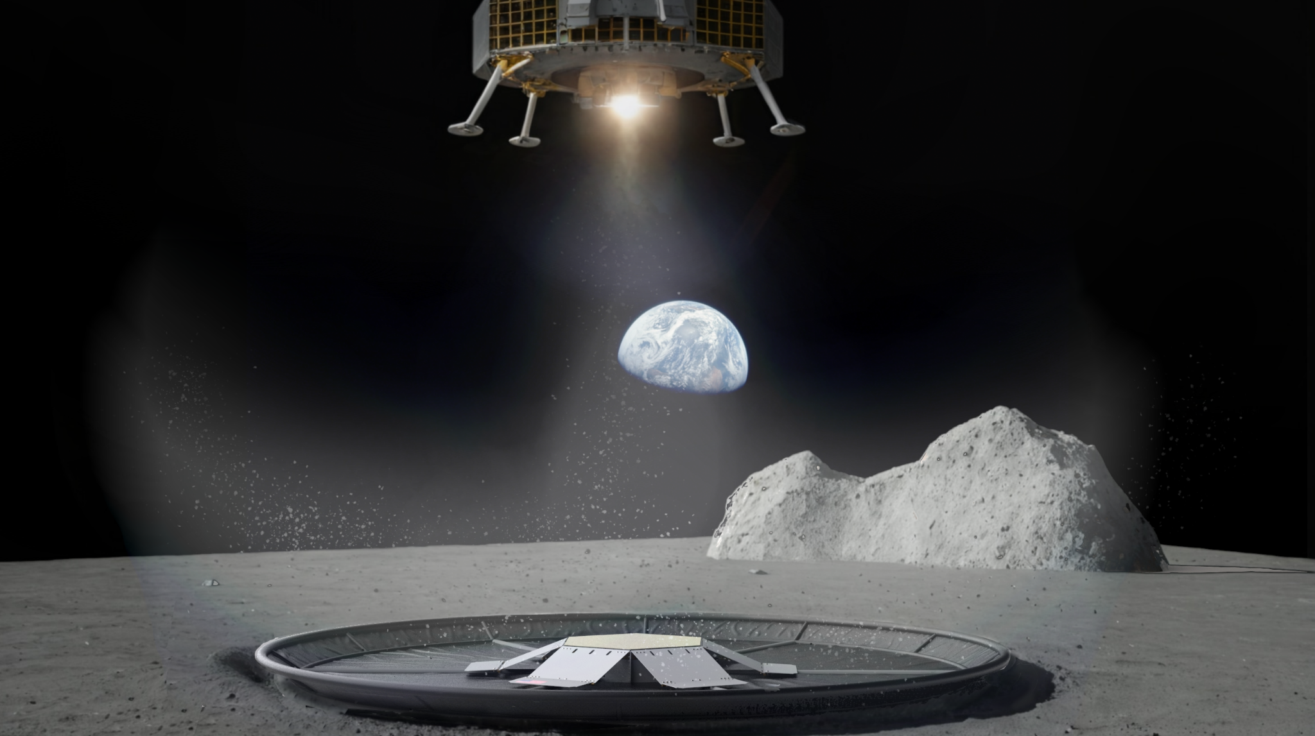

Inflatable Lunar Landing Pad System
Arizona State University
Grant Lesley: Undergraduate, Mechanical Engineering
Elizabeth Arnold: Graduate, Computer Systems Engineering
Christina Sturgeon: Undergraduate, Mechanical Engineering
Diwitha Rajmohan: Undergraduate, Electrical Engineering
Ellie Moran: Undergraduate, Chemical Engineering
Eddie Ormseth: Undergraduate, Mathematics and Computer Science
Grace Reiter: Undergraduate, Sustainability
Kennedy Gourdine: Undergraduate, Sustainability
Vaibhav Khanna: Graduate, Mechanical Engineering (foreign national)
Georgia Lee: Undergraduate, Mechanical Engineering
Connor Owens: Undergraduate, Mechanical Engineering
Jordan Huggett: Undergraduate, Mechanical Engineering
Haley Smallwood: Graduate, Industrial Design
Tokiya Aono: Undergraduate, Fashion Design (foreign national)
Sarwan Shah: Graduate, Electrical Engineering (foreign national)
Om Panchal: Graduate, Aerospace Engineering (foreign national)
Ahmed Nasr: Undergraduate, Electrical Engineering
Nick Nguyen: Undergraduate, Computer Systems Engineering (foreign national)
Vianka Jauregui: Undergraduate, Graphic Design (Graduated May 2024)
Brian Ridenour: Graduate, Material Science (Graduated May 2024)
Benjamin Schnieper: Undergraduate, Industrial Design (Graduated May 2024)
Faculty Advisors
James Bell, Professor, Arizona State University,
James Rice, Asst Research Scientist, Arizona State University
Tyler Smith, Sr. Director, The Luminosity Lab, Arizona State University

Slide 2
Presentation Overview
Problem Statement
Solution Overview
Concept of Operations
Project Description
Manufacturing
Relevant Environment Testing
Earth Analog Testing
Path To Flight

Slide 3
PROBLEM STATEMENT

Slide 4
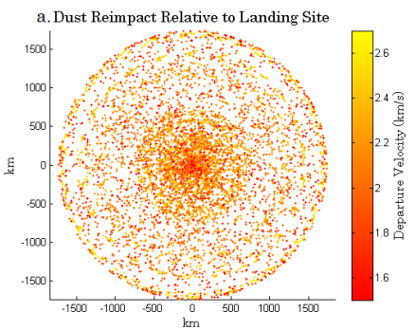
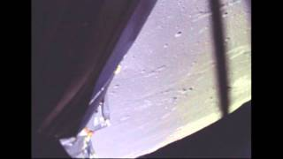
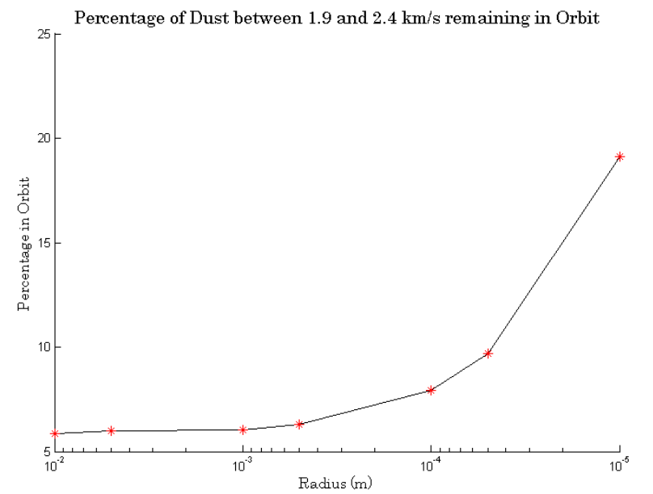
Problem Statement
[1]
[2]
~10% of regolith ejecta can enter orbit
Notes:
This year’s NASA BIG Idea Challenge is to “design, develop, and demonstrate novel uses of low Size, Weight and Power (SWaP) inflatable technologies, structures, and systems for lunar operations.” The problem we have chosen to solve using an inflatable structure is the challenges that come with landing on the lunar surface. The terrain on the lunar surface is composed of regolith, and it has been shown that the fine-grained particles in regolith are prone to create debris clouds caused by landers and can travel at typical speeds of 2 km/s, potentially resulting in damage to nearby landers or equipment. Some debris could even be ejected into lunar orbit, resulting in damage to orbiting spacecraft and further damage upon re-entry to the lunar surface. This not only poses a threat to equipment and instruments due to abrasion and contamination but also to the ability of landers to land near each other or near existing structures.

Slide 5
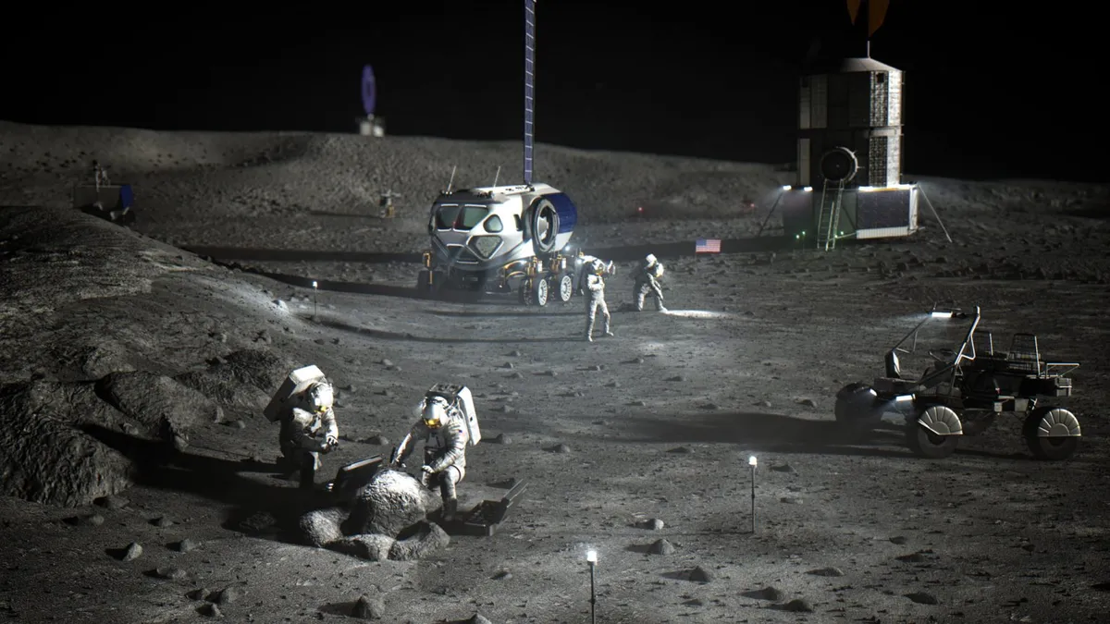
Problem Statement
[3]
Notes:
The current solution to this problem is to create safety offset zones around landers to prevent other vehicles from landing in the vicinity. For building a sustained presence on the Moon, landers will likely need to land near each other such that they can be used for collaborative purposes, for example to carry larger payloads that can be assembled on-site. It is for this reason that we are proposing Aegis as an inflatable landing system to reduce dust and debris generated by landers thereby allowing for closer proximity of landings, and potentially simplifying the construction of outposts and the establishment of a sustained human and robotic presence on the Moon.

Slide 6
System Overview

Slide 7
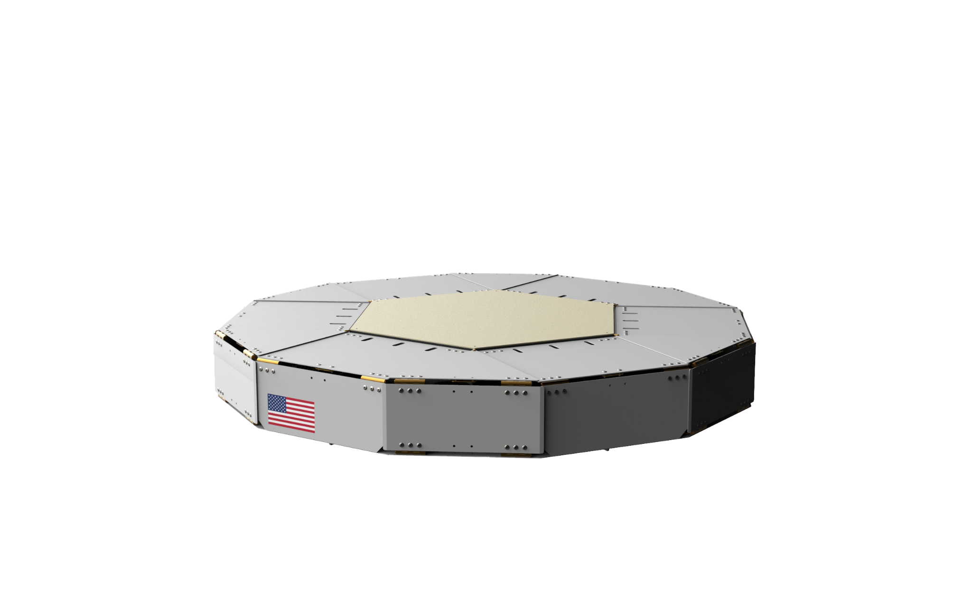
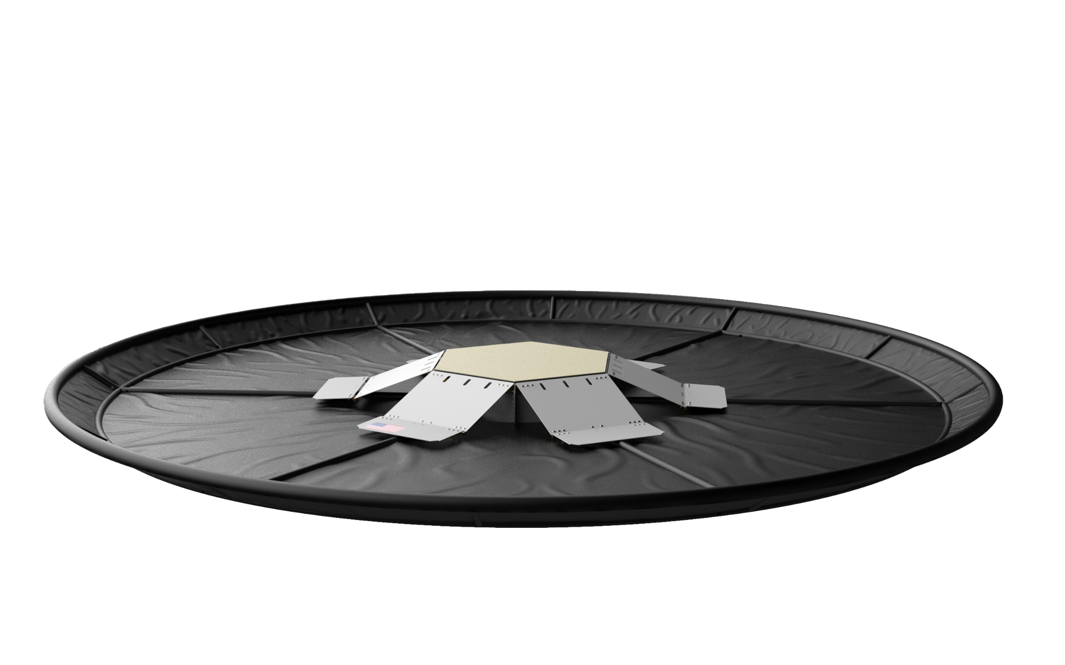
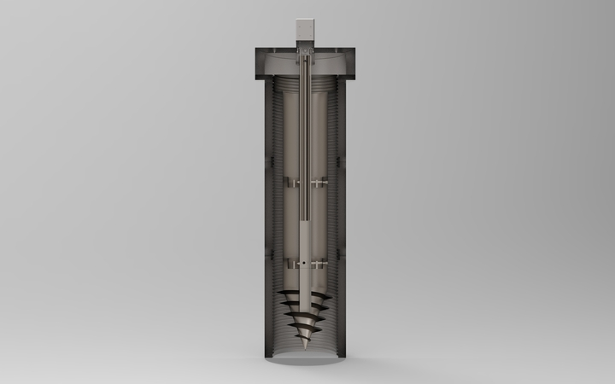
Aegis: Inflatable Landing Pad
Inflated Skeleton
Tarp
Heat Shield
Anchors
Enclosure
Notes:
Aegis is a self sufficient system which comprises 5 subsystems,

Slide 8
CONCEPT OF OPERATIONS

Slide 9
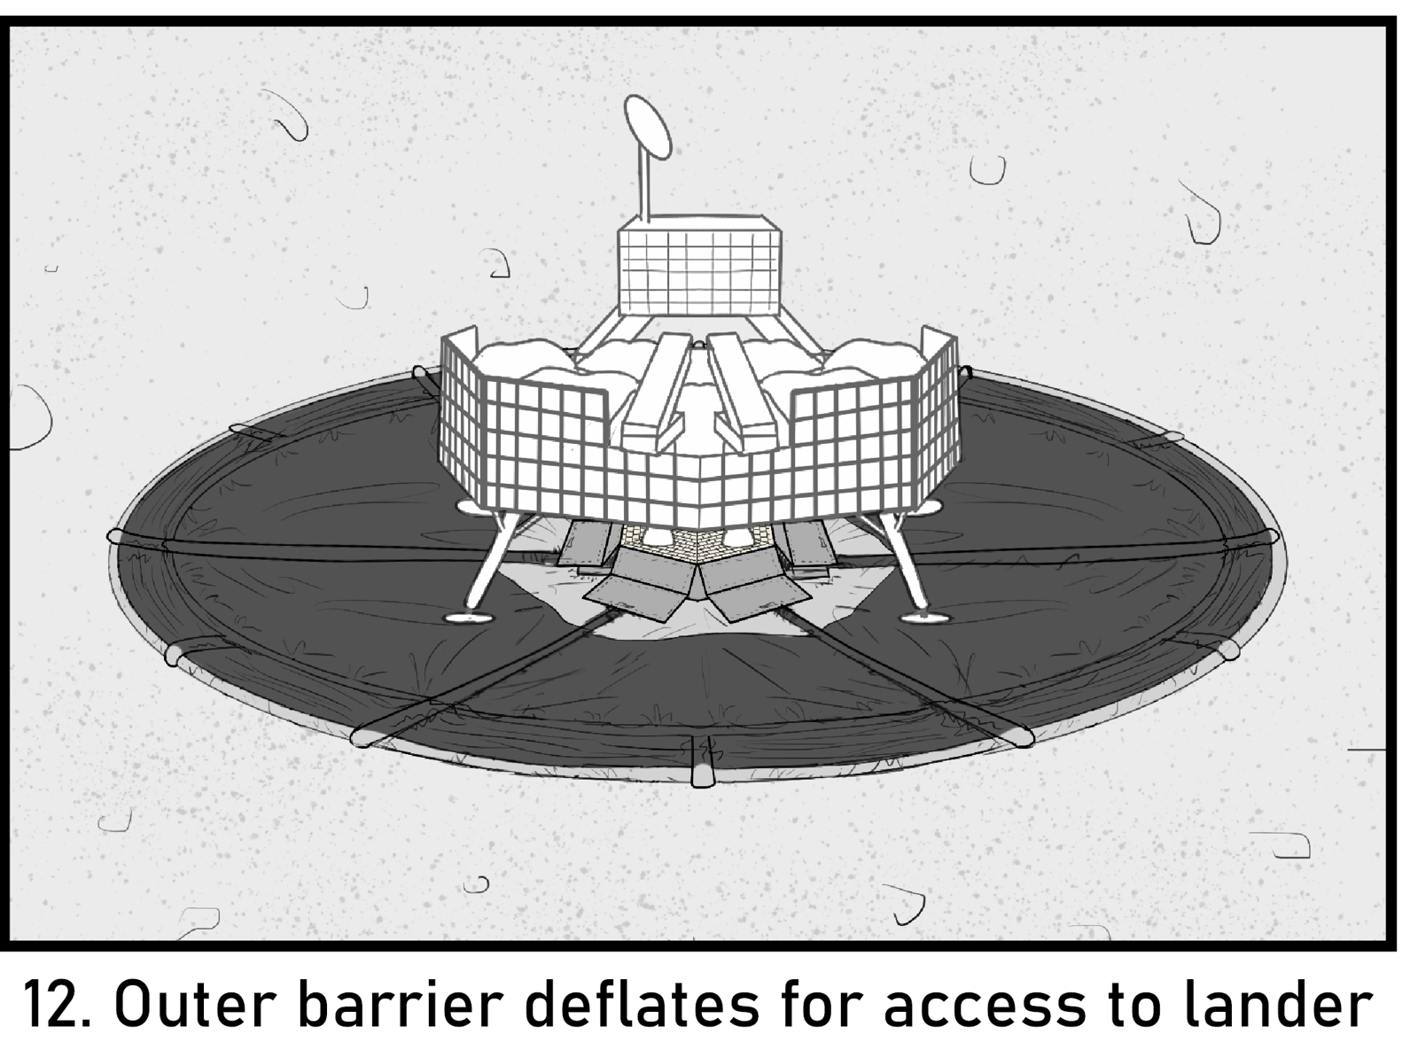
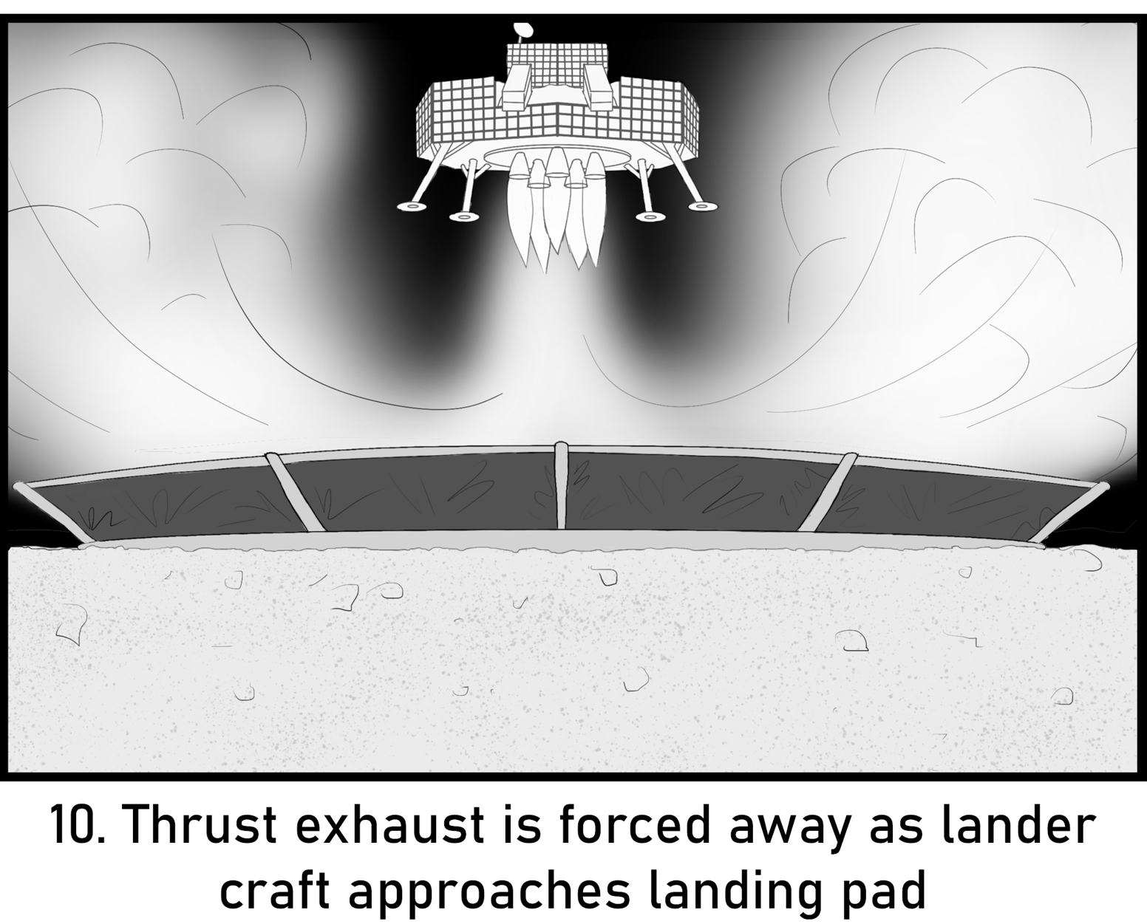
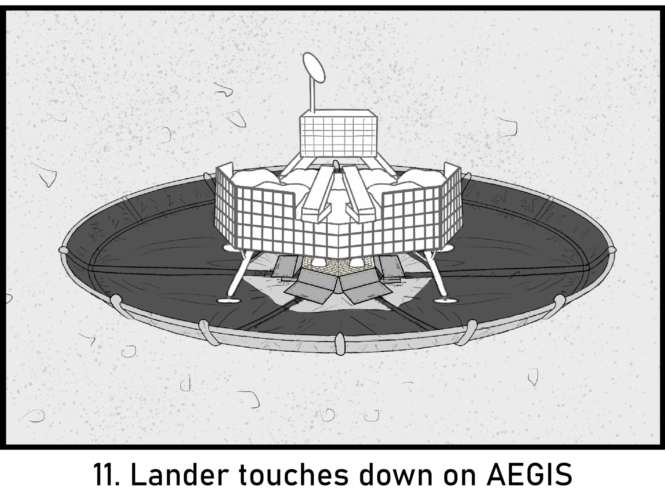
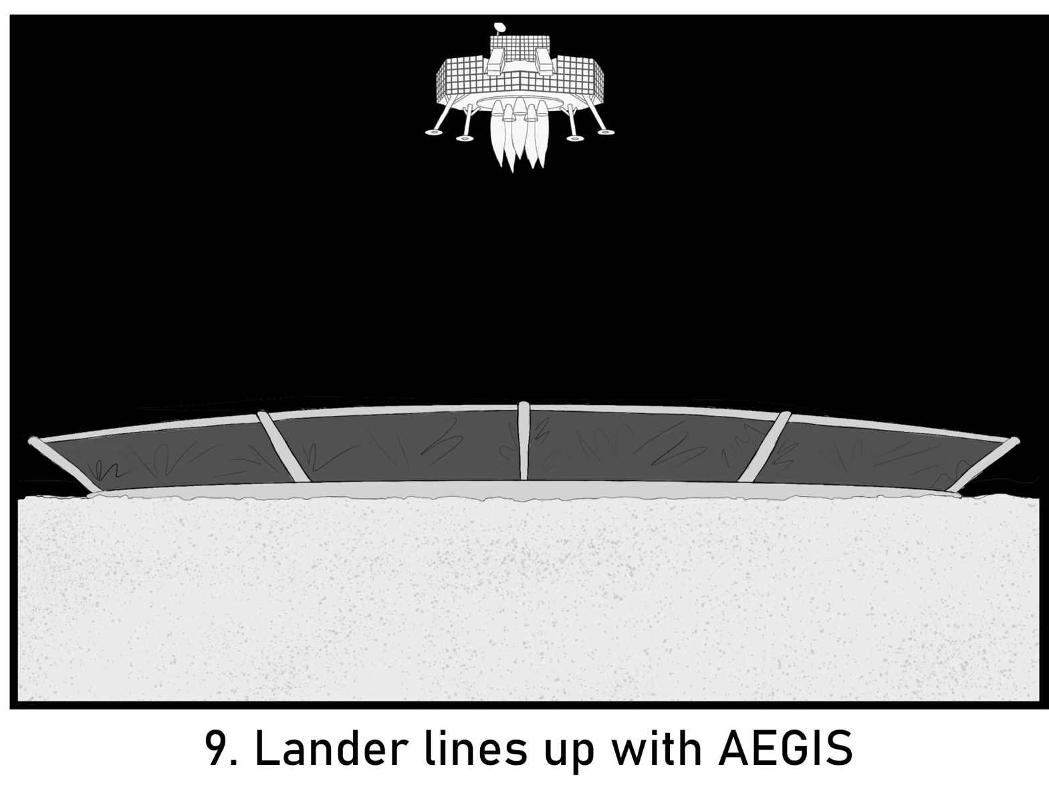
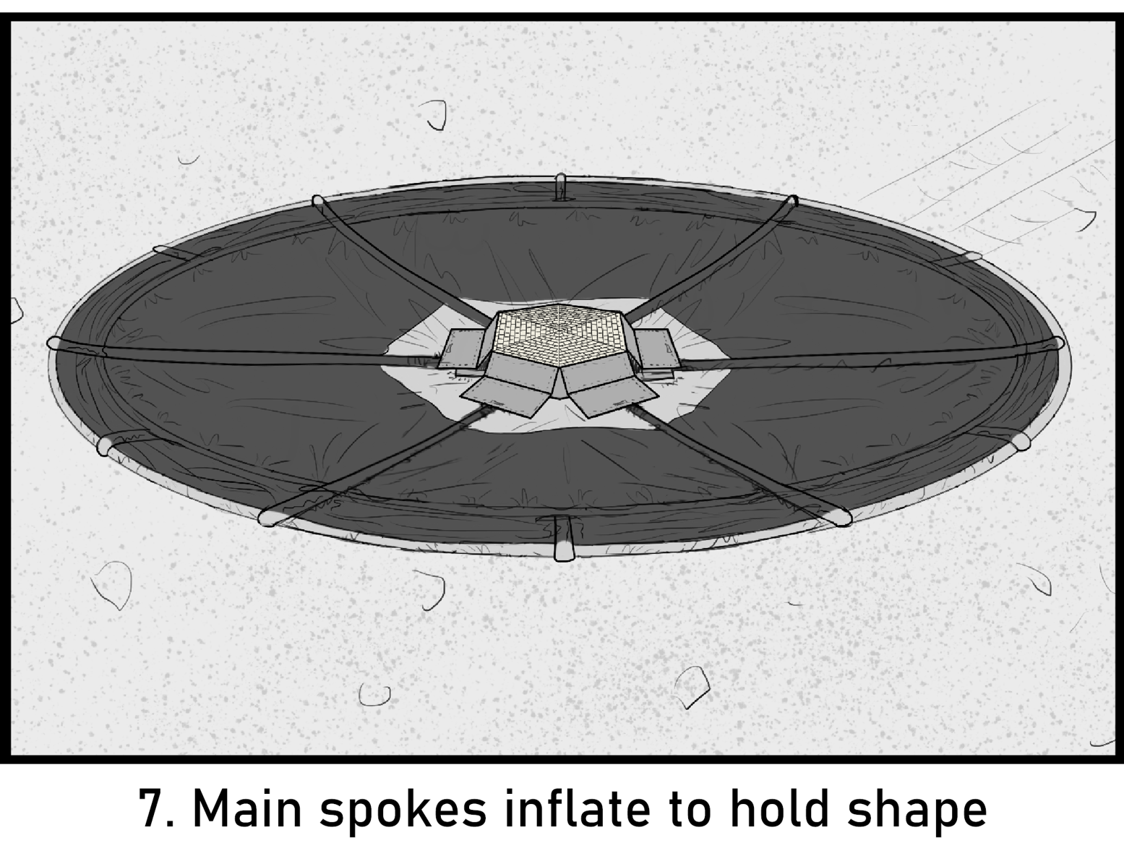
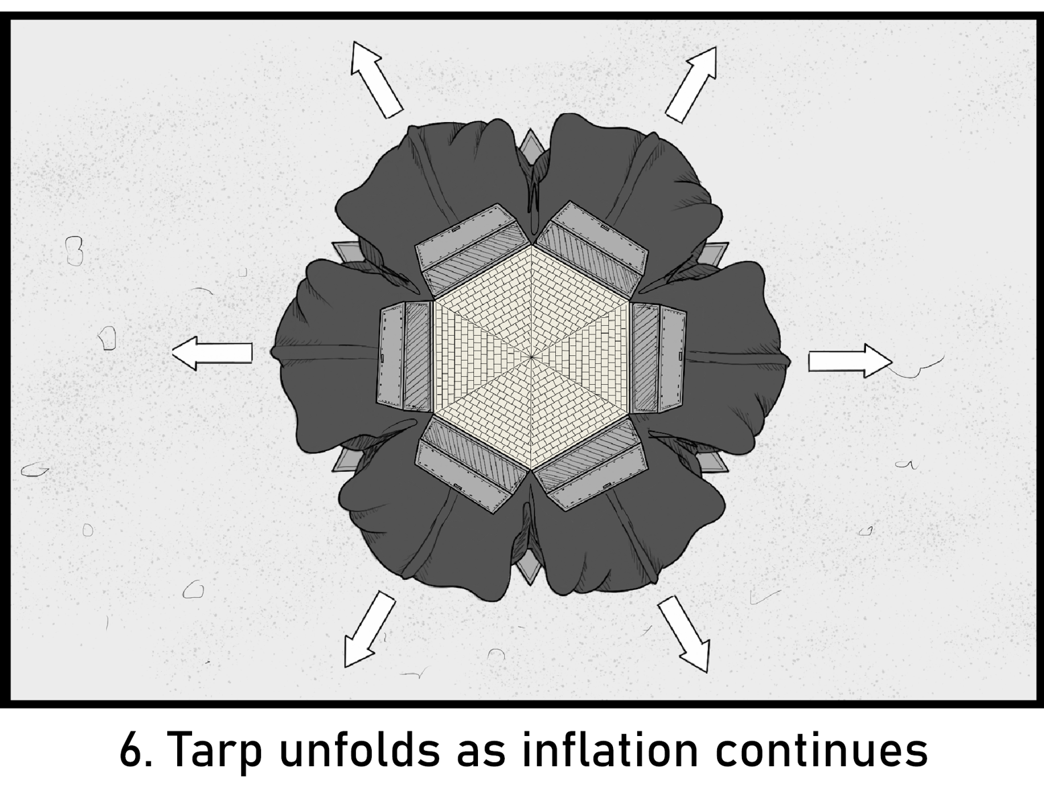
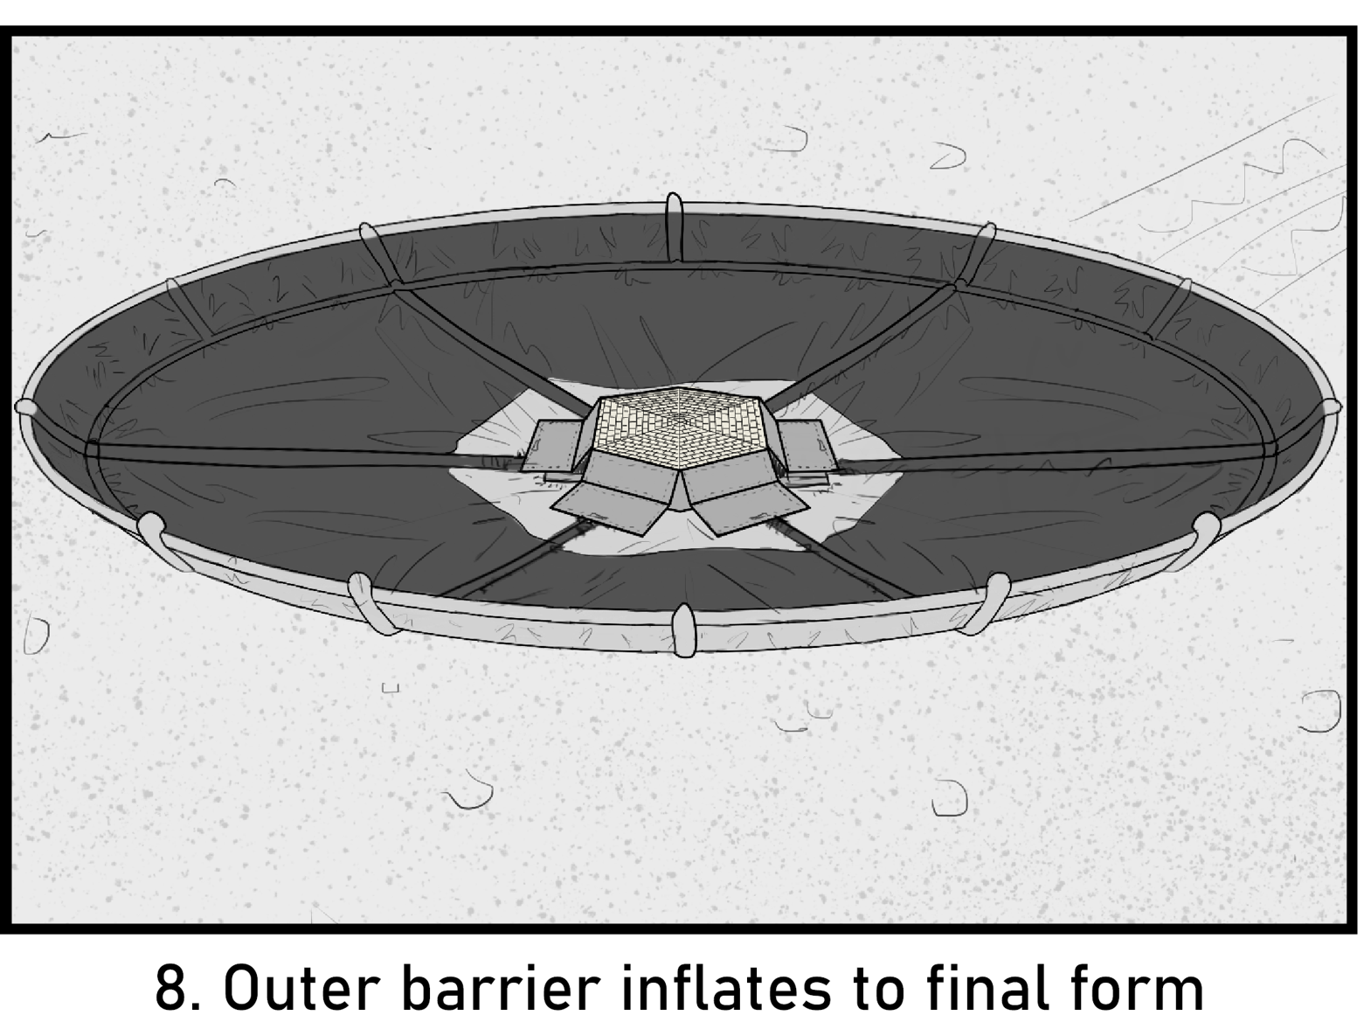
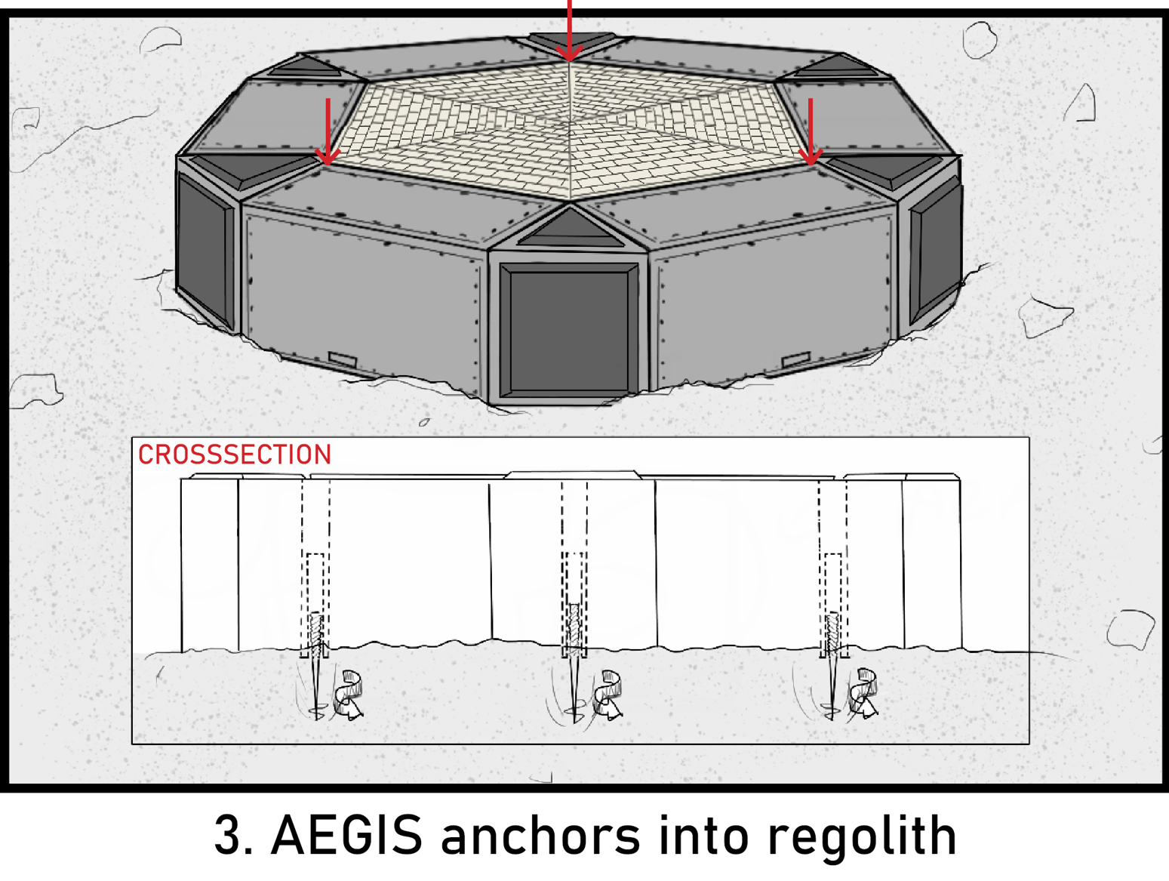
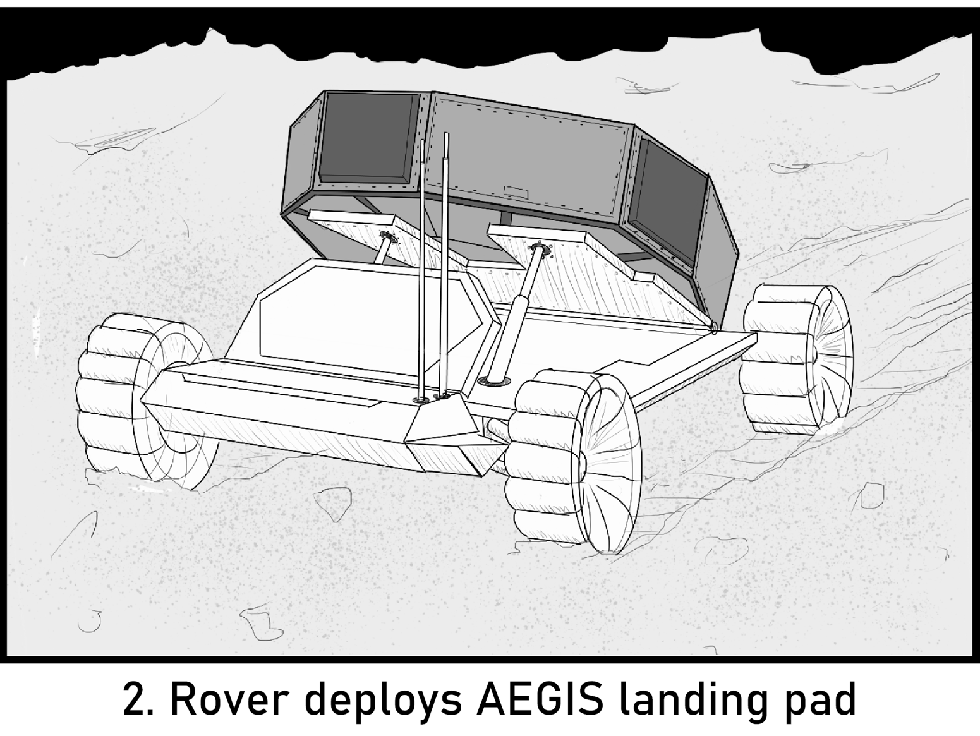
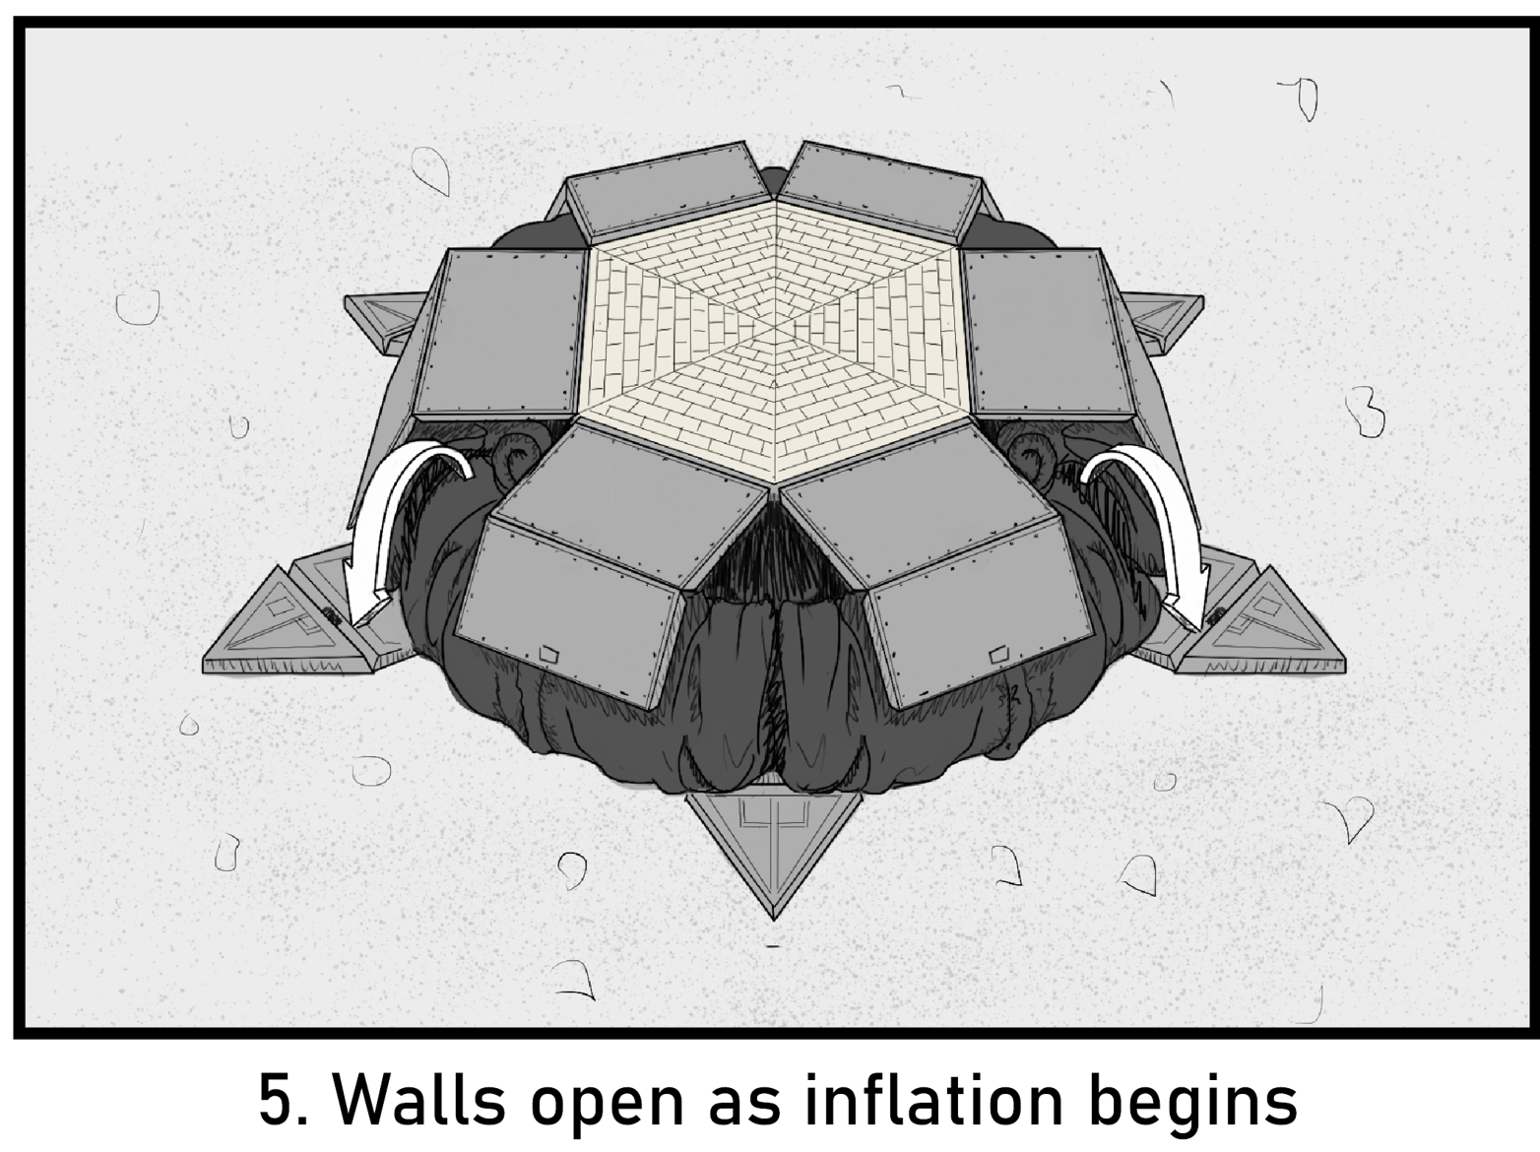
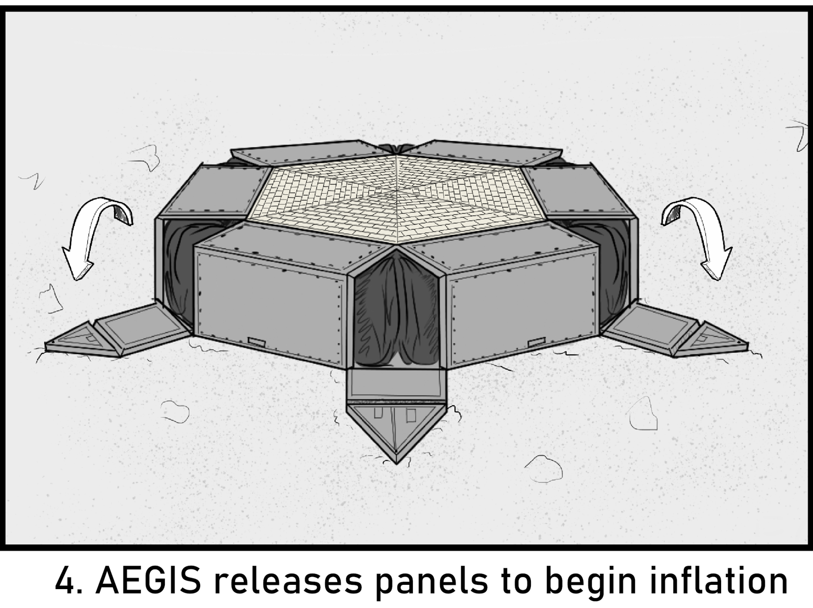
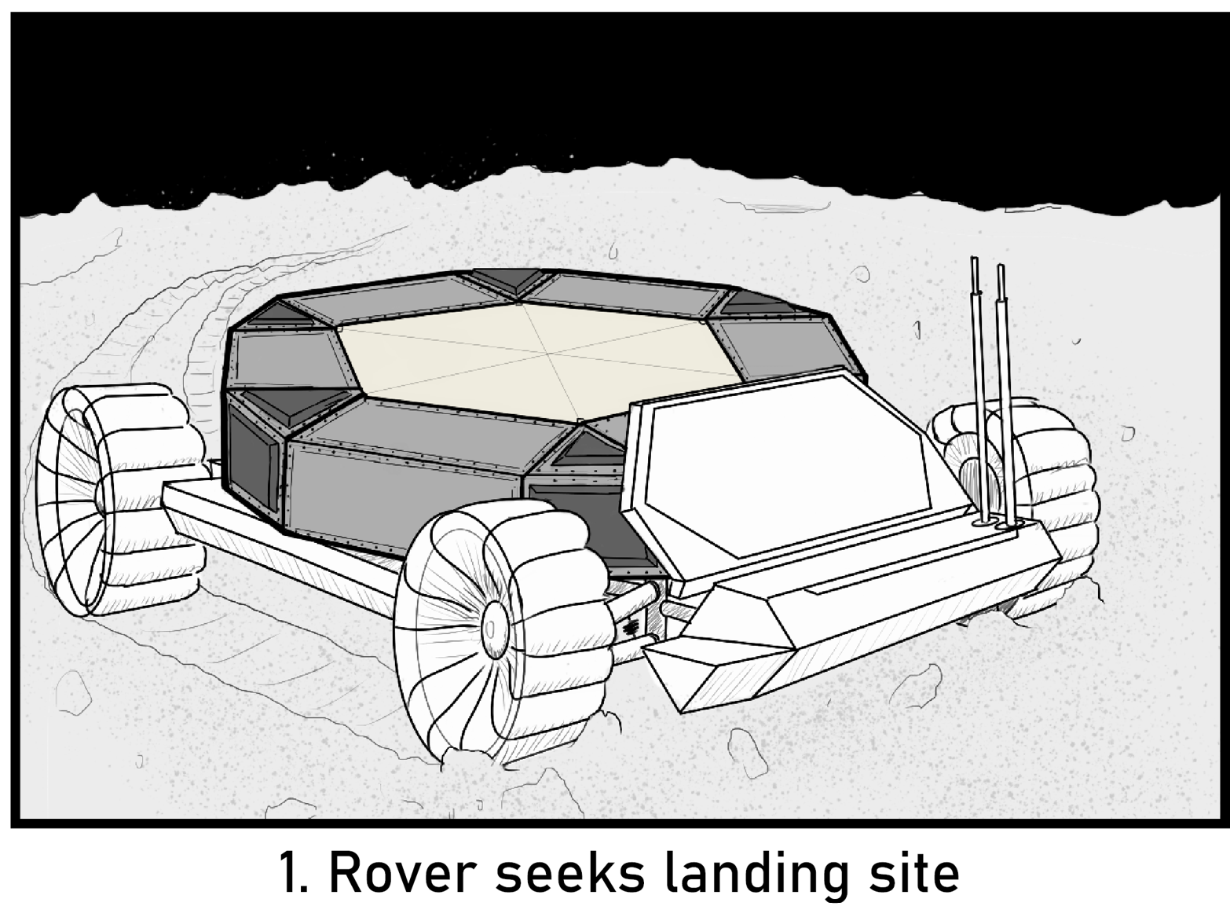
CON-OPS

Slide 10
CON-OPS

Slide 11
PROJECT DESCRIPTION

Slide 12
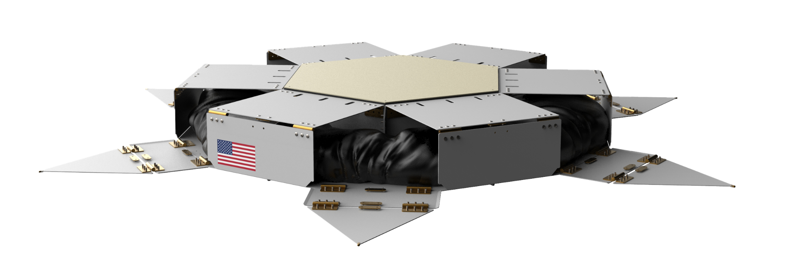
ENCLOSURE
Nested Central Heat Shield
Frangible Release Nuts
6061 Aluminum Sheet Metal
Spring Loaded Exterior Panels

Slide 13
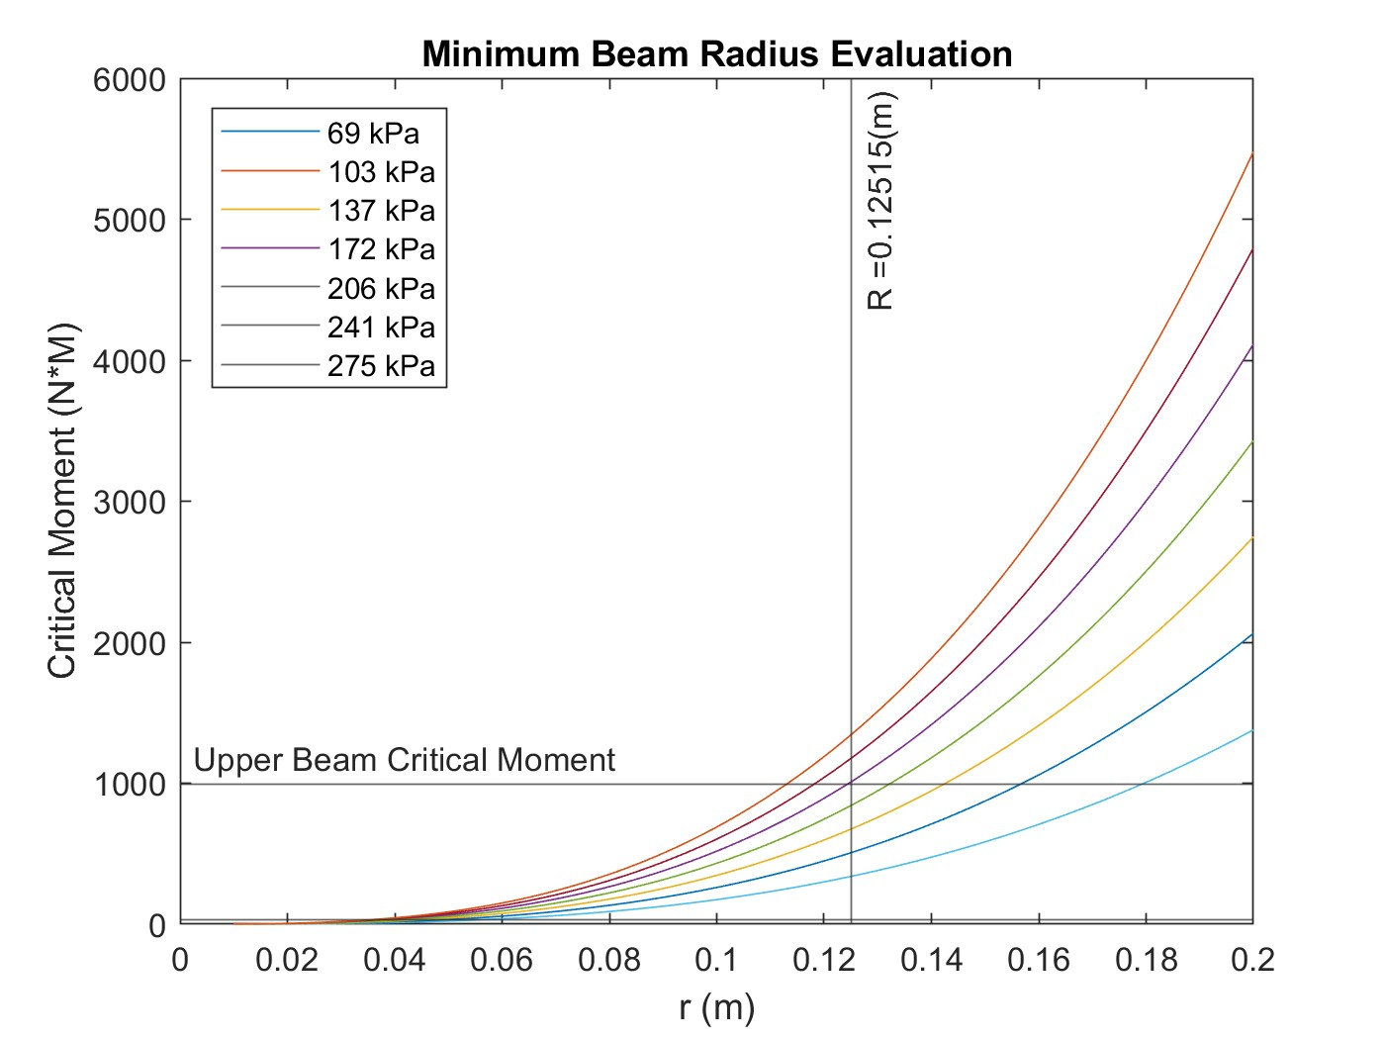
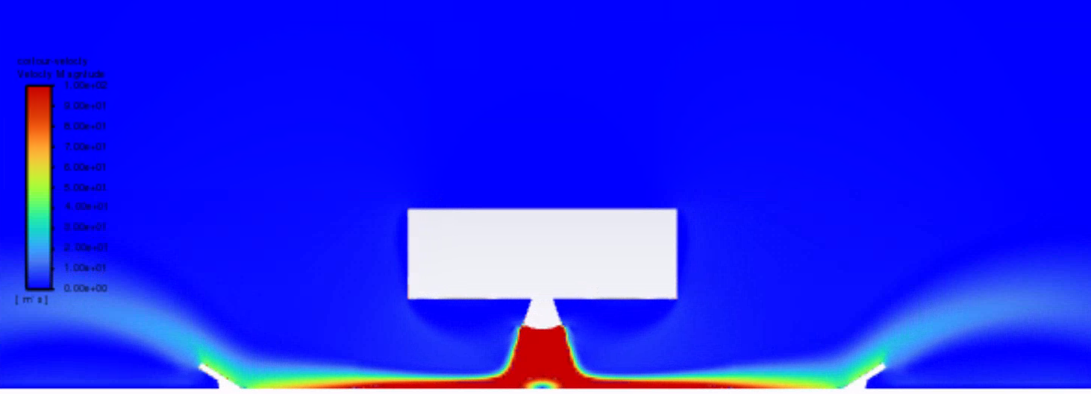
INFLATION SYSTEM
12.7cm Inflated Kevlar Beams
153 m² Deployed Coverage
Check Valve Inflation
95% reduction in Fluid Shear Stress
0.21 m³ of Nitrogen at 15 MPa

Slide 14
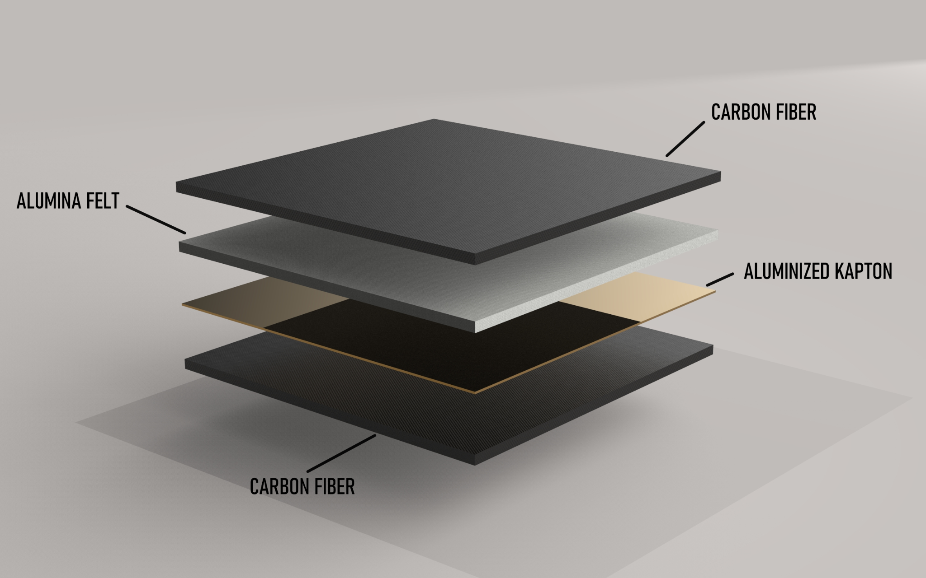
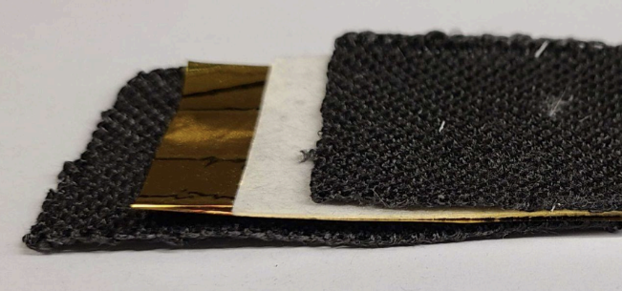
TARP
Layer Assembly
Stitched with ceramic thread for durability
Material Justifications:
Aluminized Kapton: Air Permeation
Carbon Fiber: Mechanical integrity
Alumina Felt: Conductive heat transfer
1 mm
1 mm
0.0254 mm
1 mm
Notes:
Their use in reinforcing layers of the tarp and heat shield ensured mechanical durability without compromising thermal protection.
Carbon fiber - structural component
Alumina felt assists in insulation
Kapton - reduces air permeability
This combination is all to provide structural integrity and thermal insulation in addition to resistance to gas impermeability, all while providing flexibility and compatibility in housing.

Slide 15
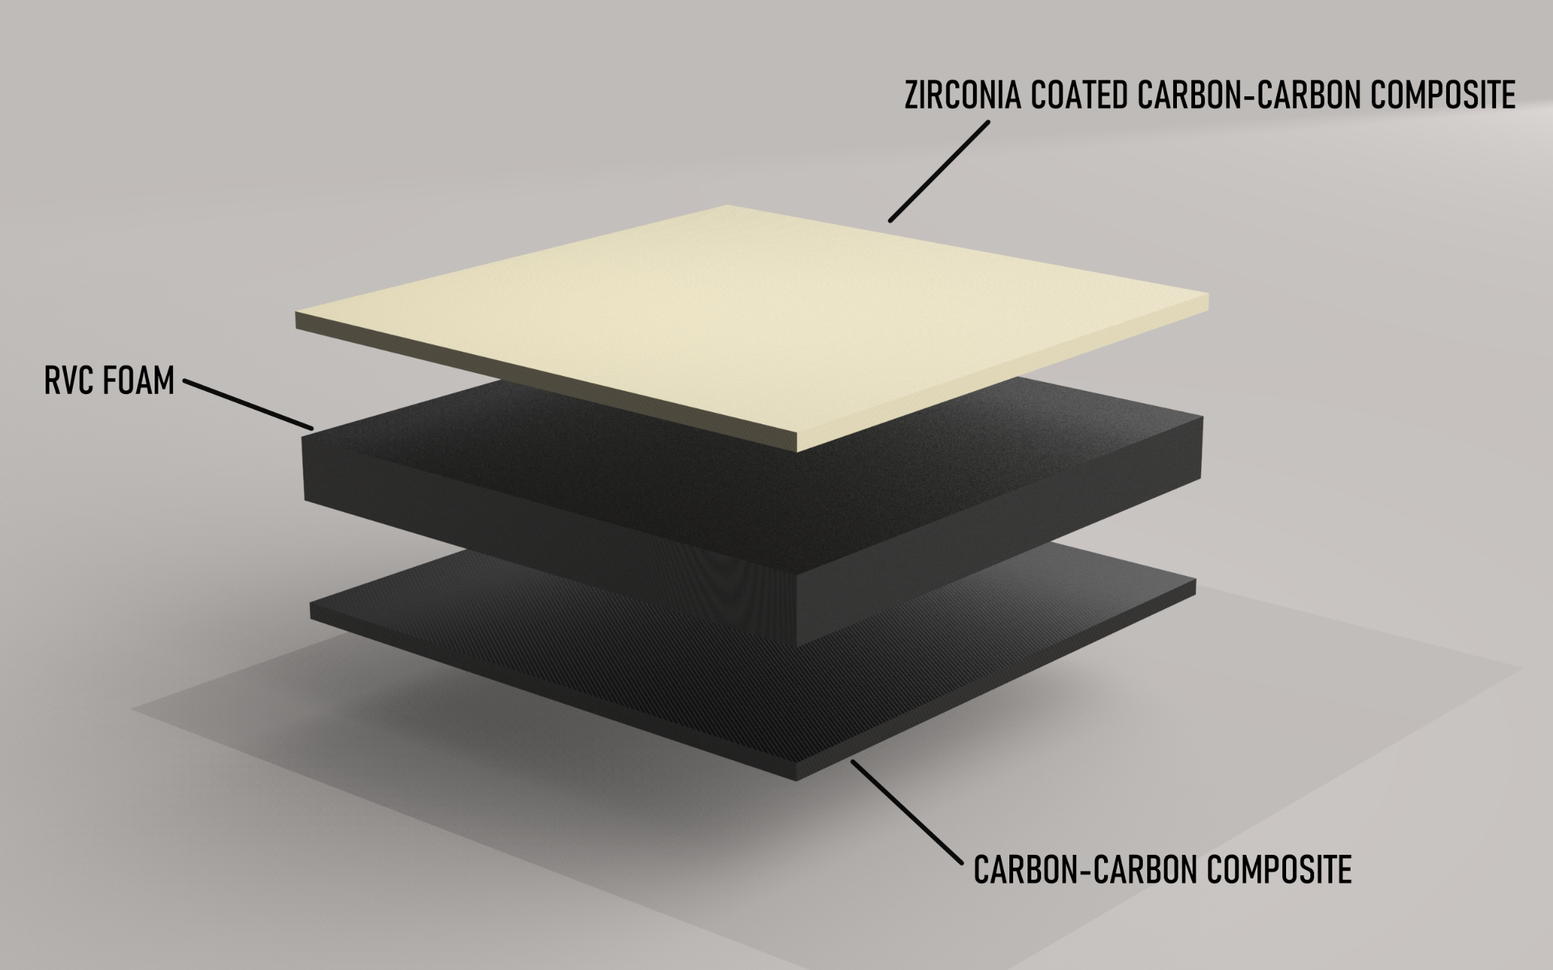
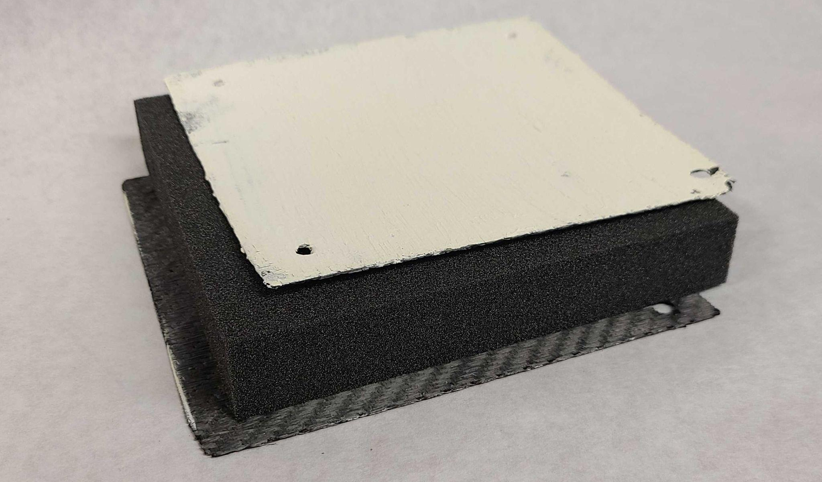
HEAT SHIELD
Layer Assembly
Inspired by Parker Solar Probe
Installed on mylar spacers creating a vacuous pocket
Material Justifications:
RVC Foam: Insulating barrier
Carbon-carbon composite: Thermal degradation protection
Plasma Sprayed Zirconia for a TBC
25.4 mm
1 mm
Notes:
Plasma sprayed zirconia was used for thermal barrier coating

Slide 16
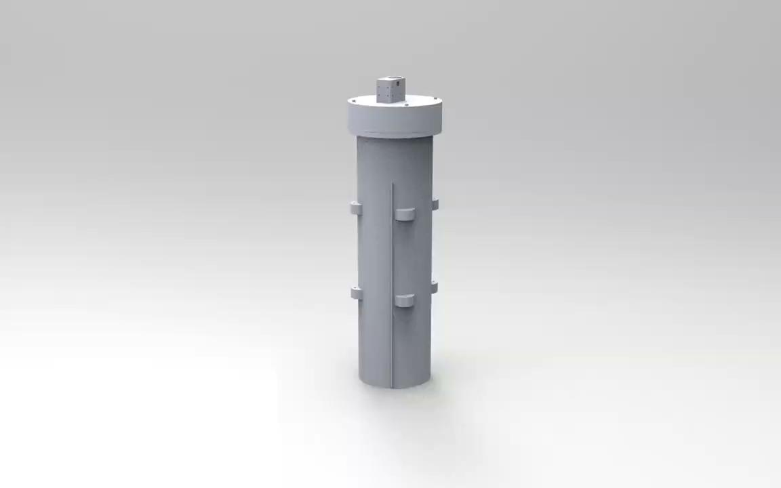
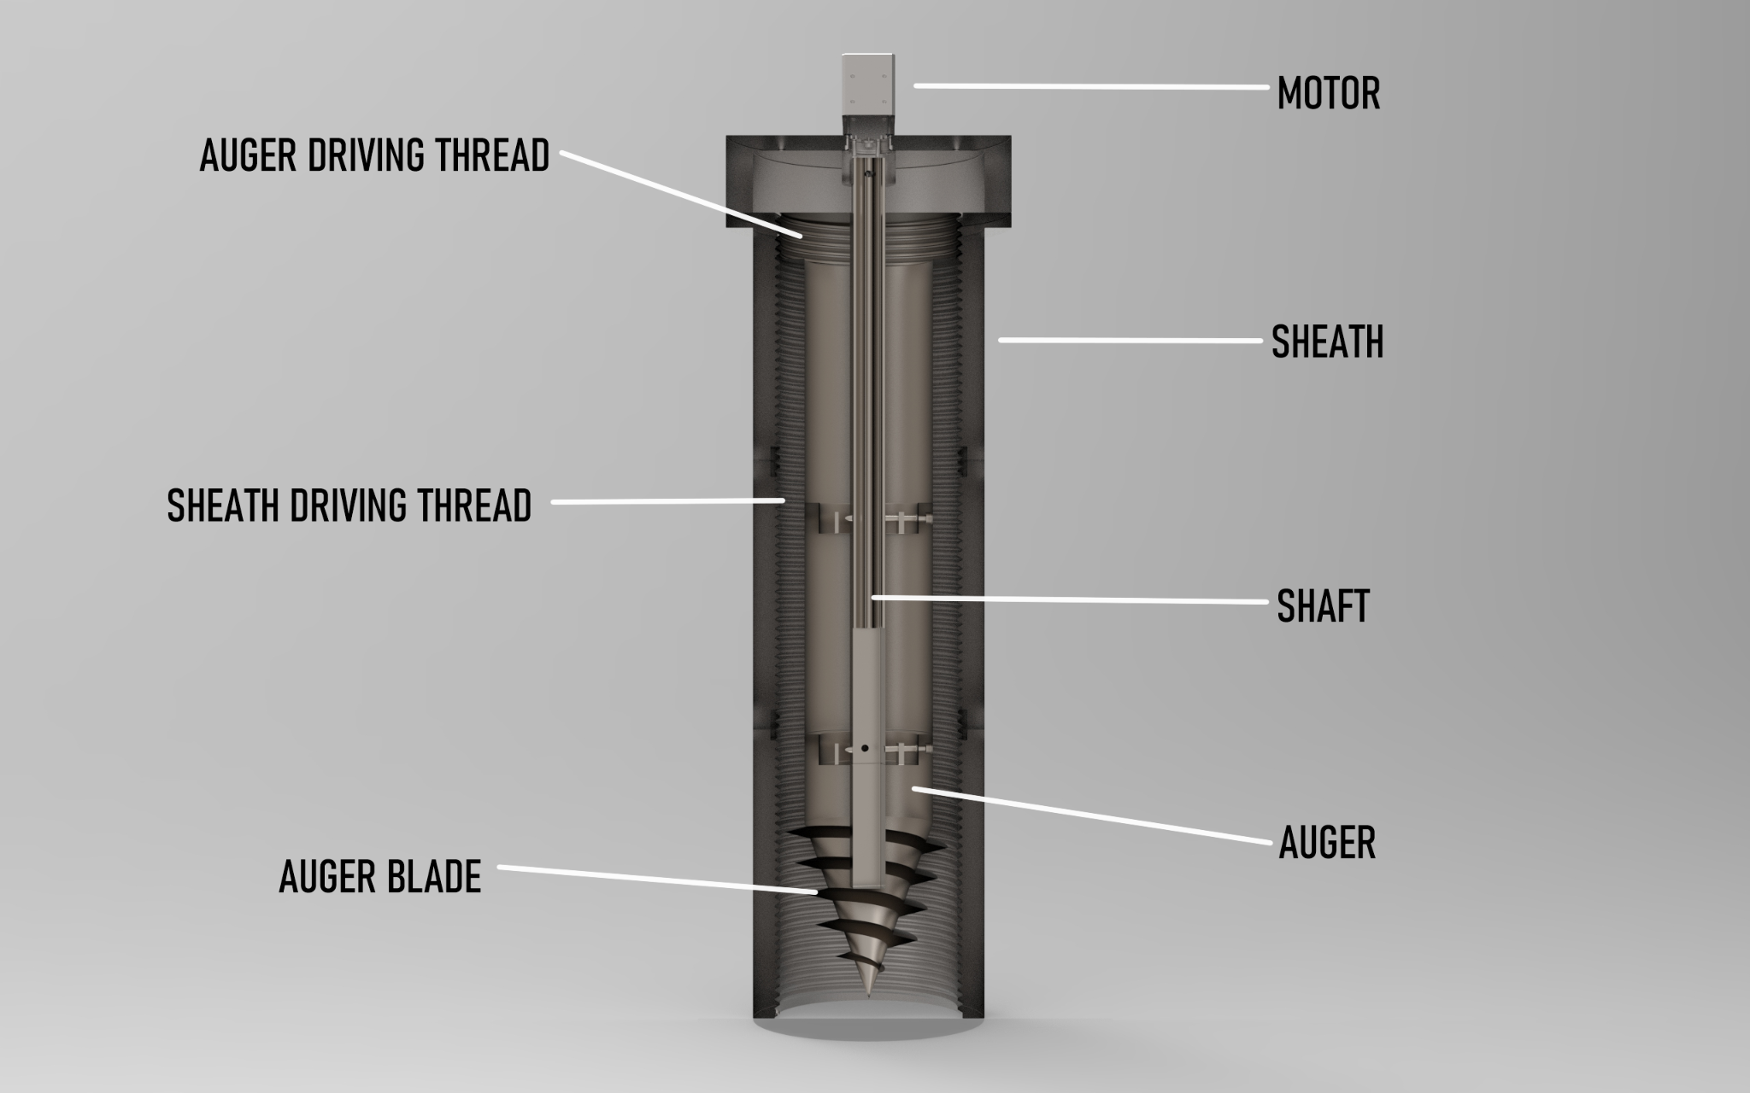
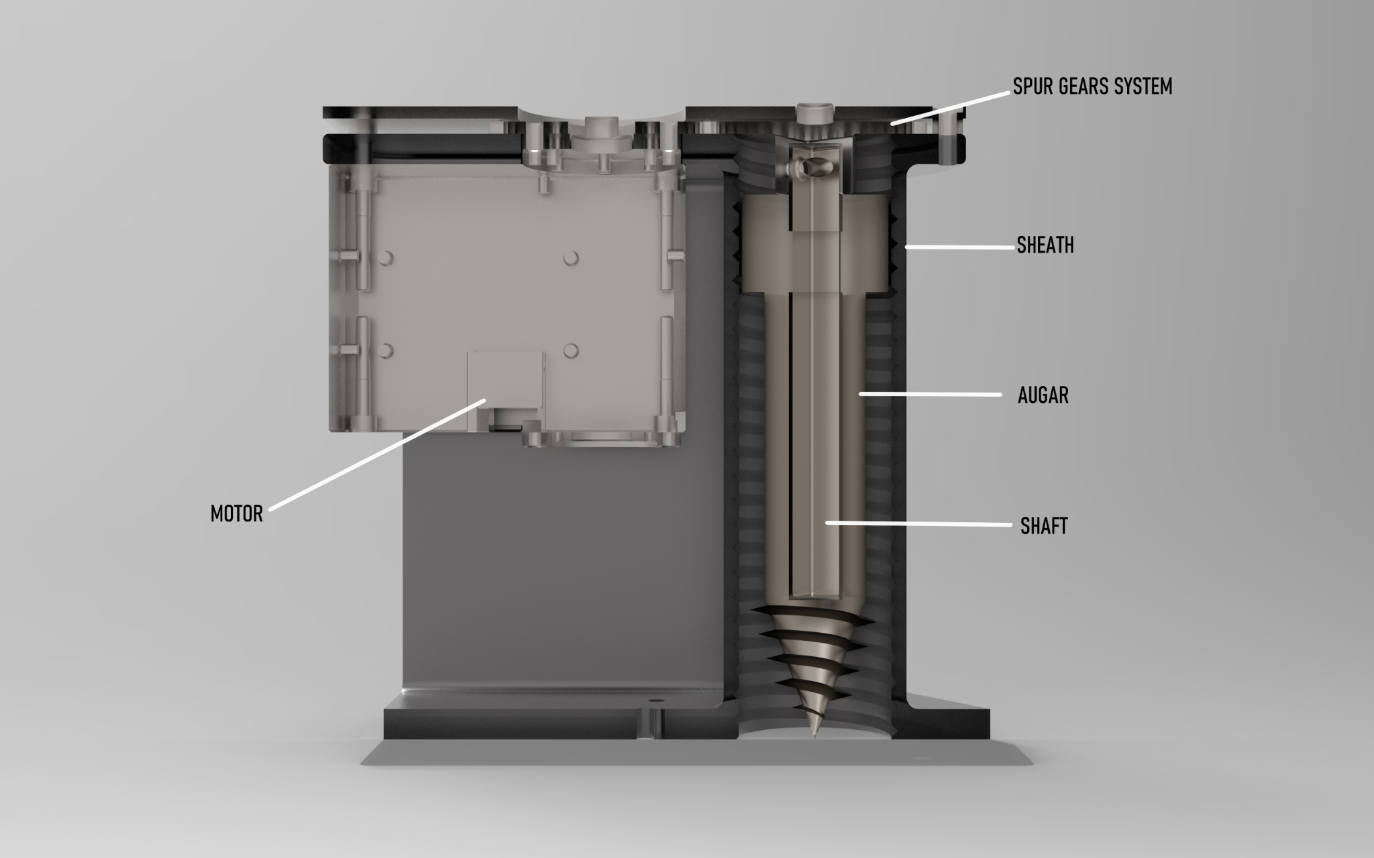
ANCHORS
Full Scale
Designed to support the system vertically and laterally
Novel deployment system to allow for the deployment of helical piles on the moon
Due to the winding nature of the driving thread, the blade of the helical pile acts as an auger and assists in embedding the system.
1/5 Scale
Notes:
The system consists of an auger, sheath, shaft, and motor. The motor induces angular movement on the shaft which in turn rotates the auger. The driving thread on the auger transforms this angular motion into a vertical motion into the ground. While the auger is rotating the auger’s blade engages the soil and helps to pull the soil up reducing the moment required to deploy the auger.

Slide 17
MANUFACTURING

Slide 18
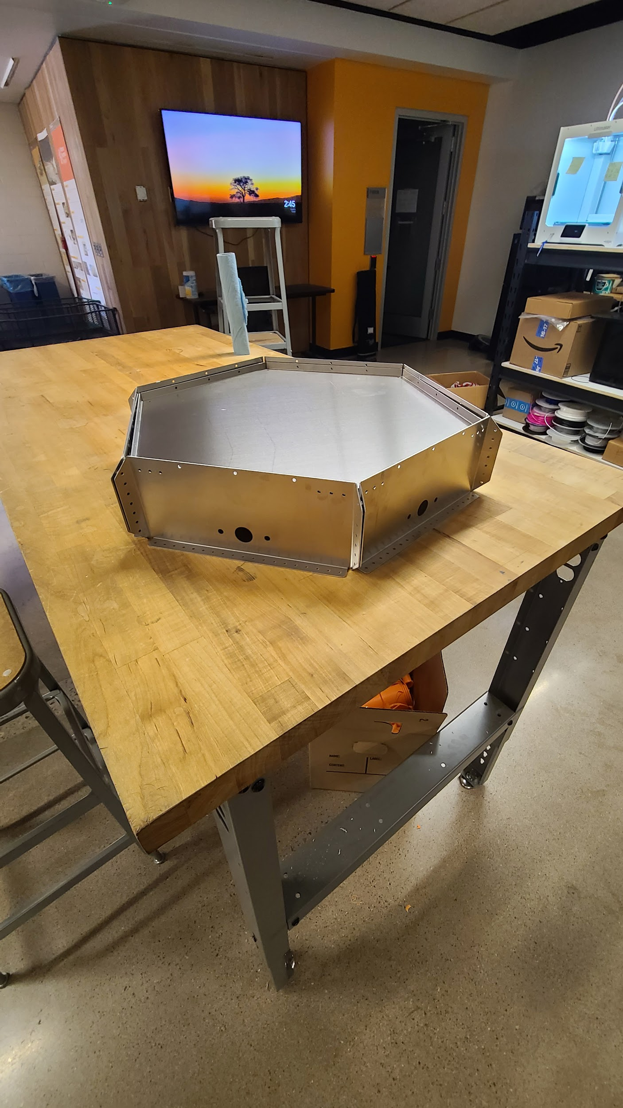
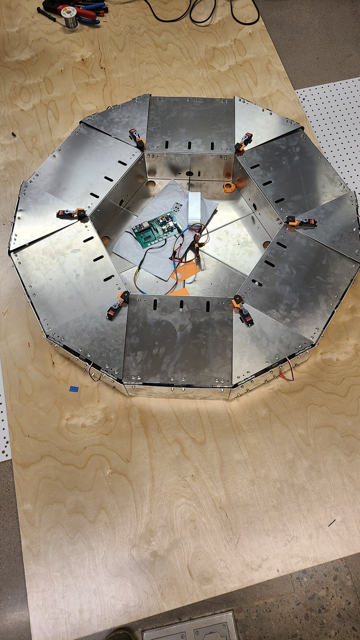
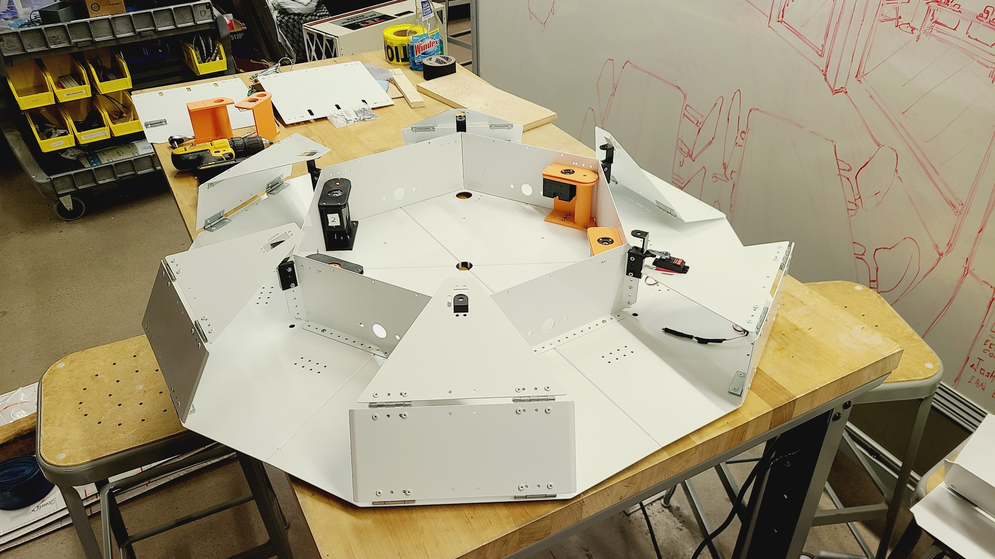
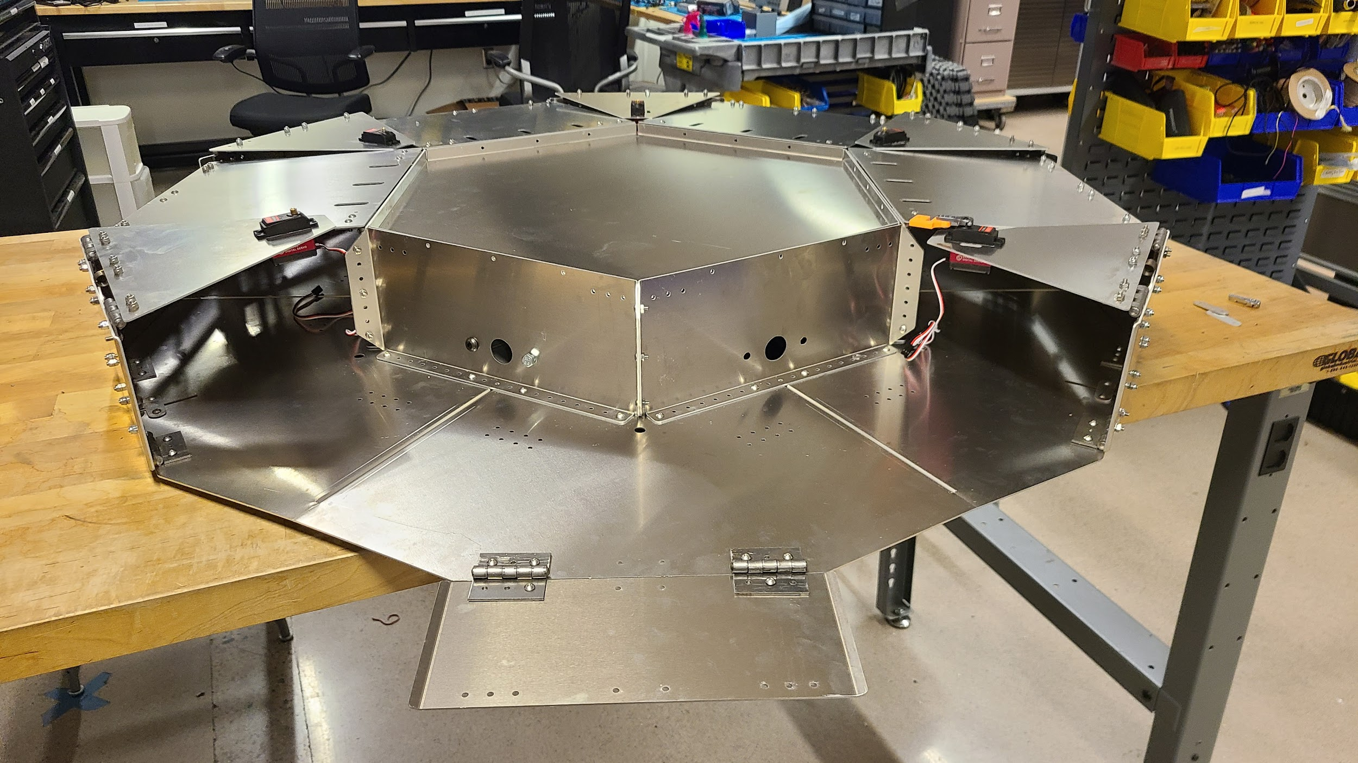
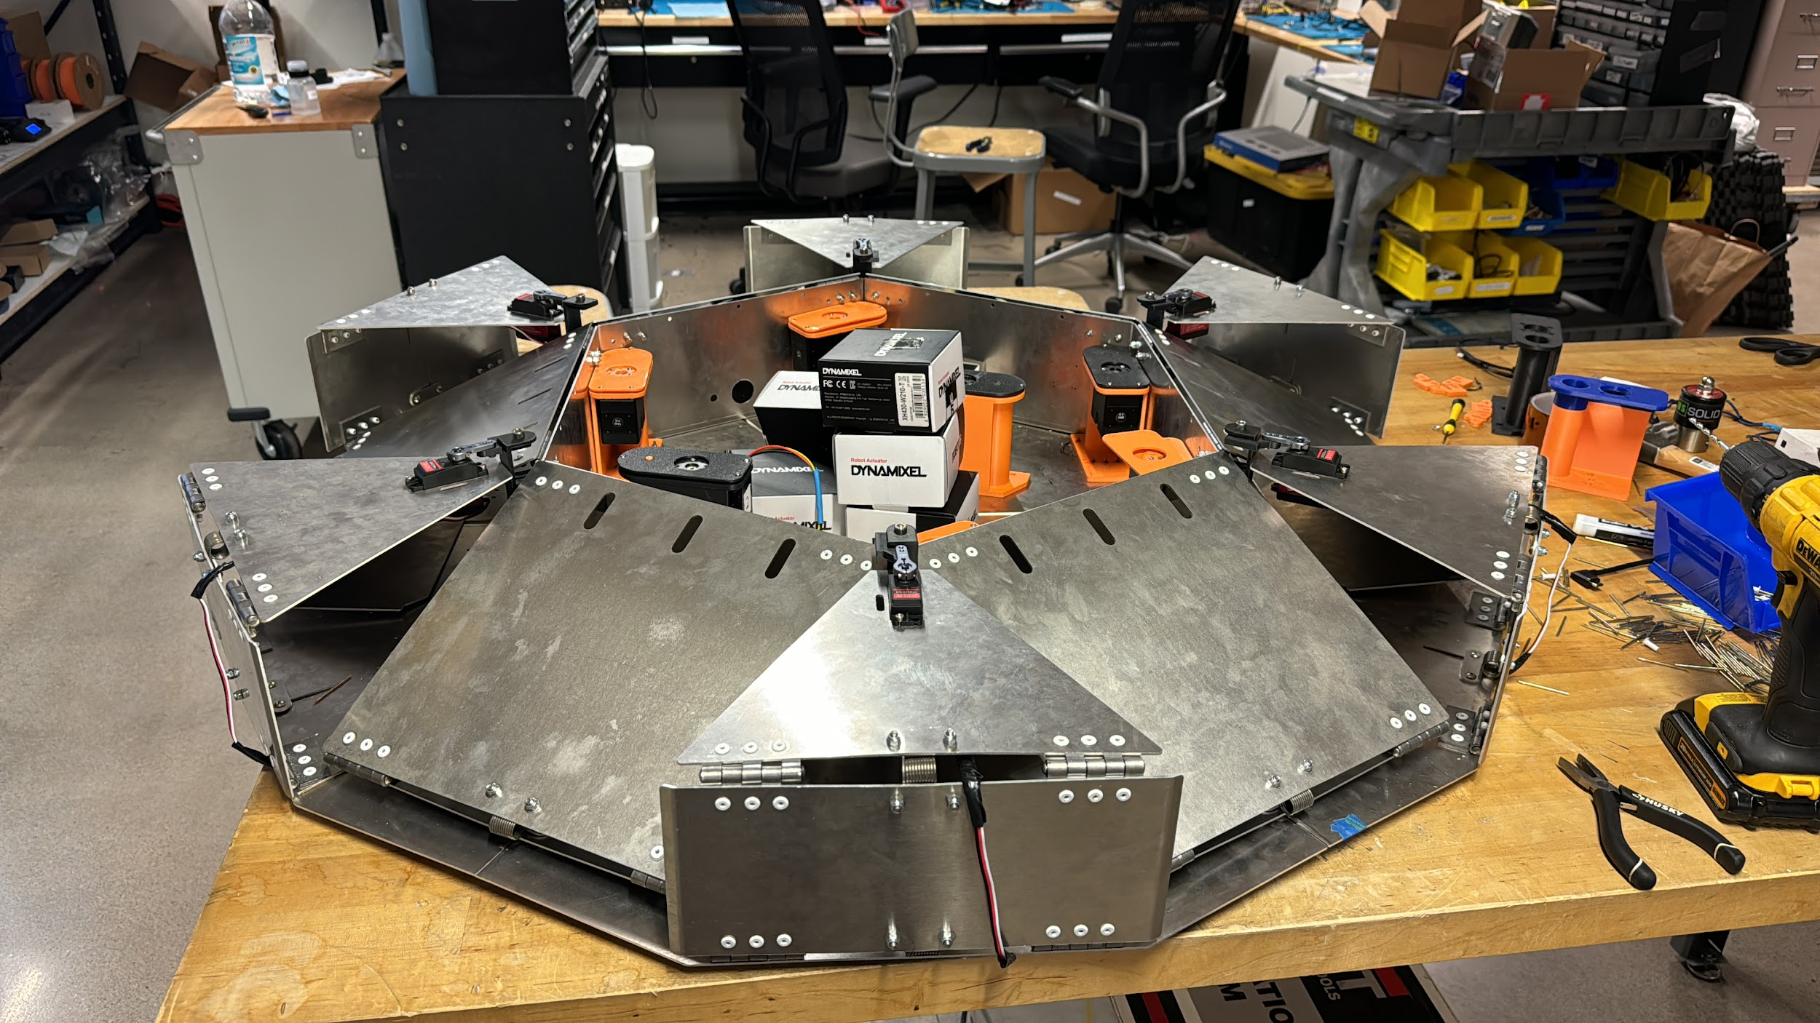
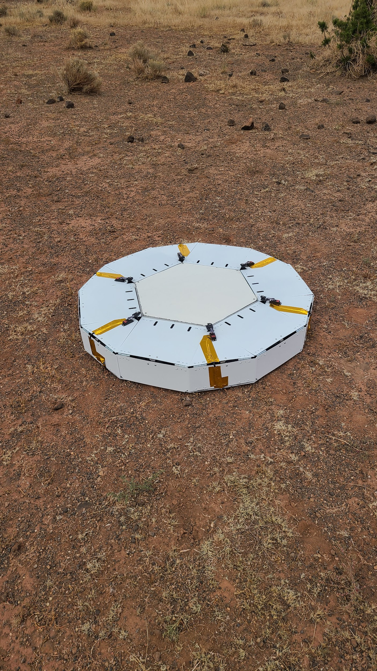
ENCLOSURE
Notes:
The enclosure was manufactured from aluminum to reduce the weight and increase adaptability. The silver enclosure was made and used in the rocket fire testing. The white final enclosure was used for earth analog environment testing due to the rapid unscheduled disassembly of the silver enclosure.

Slide 19
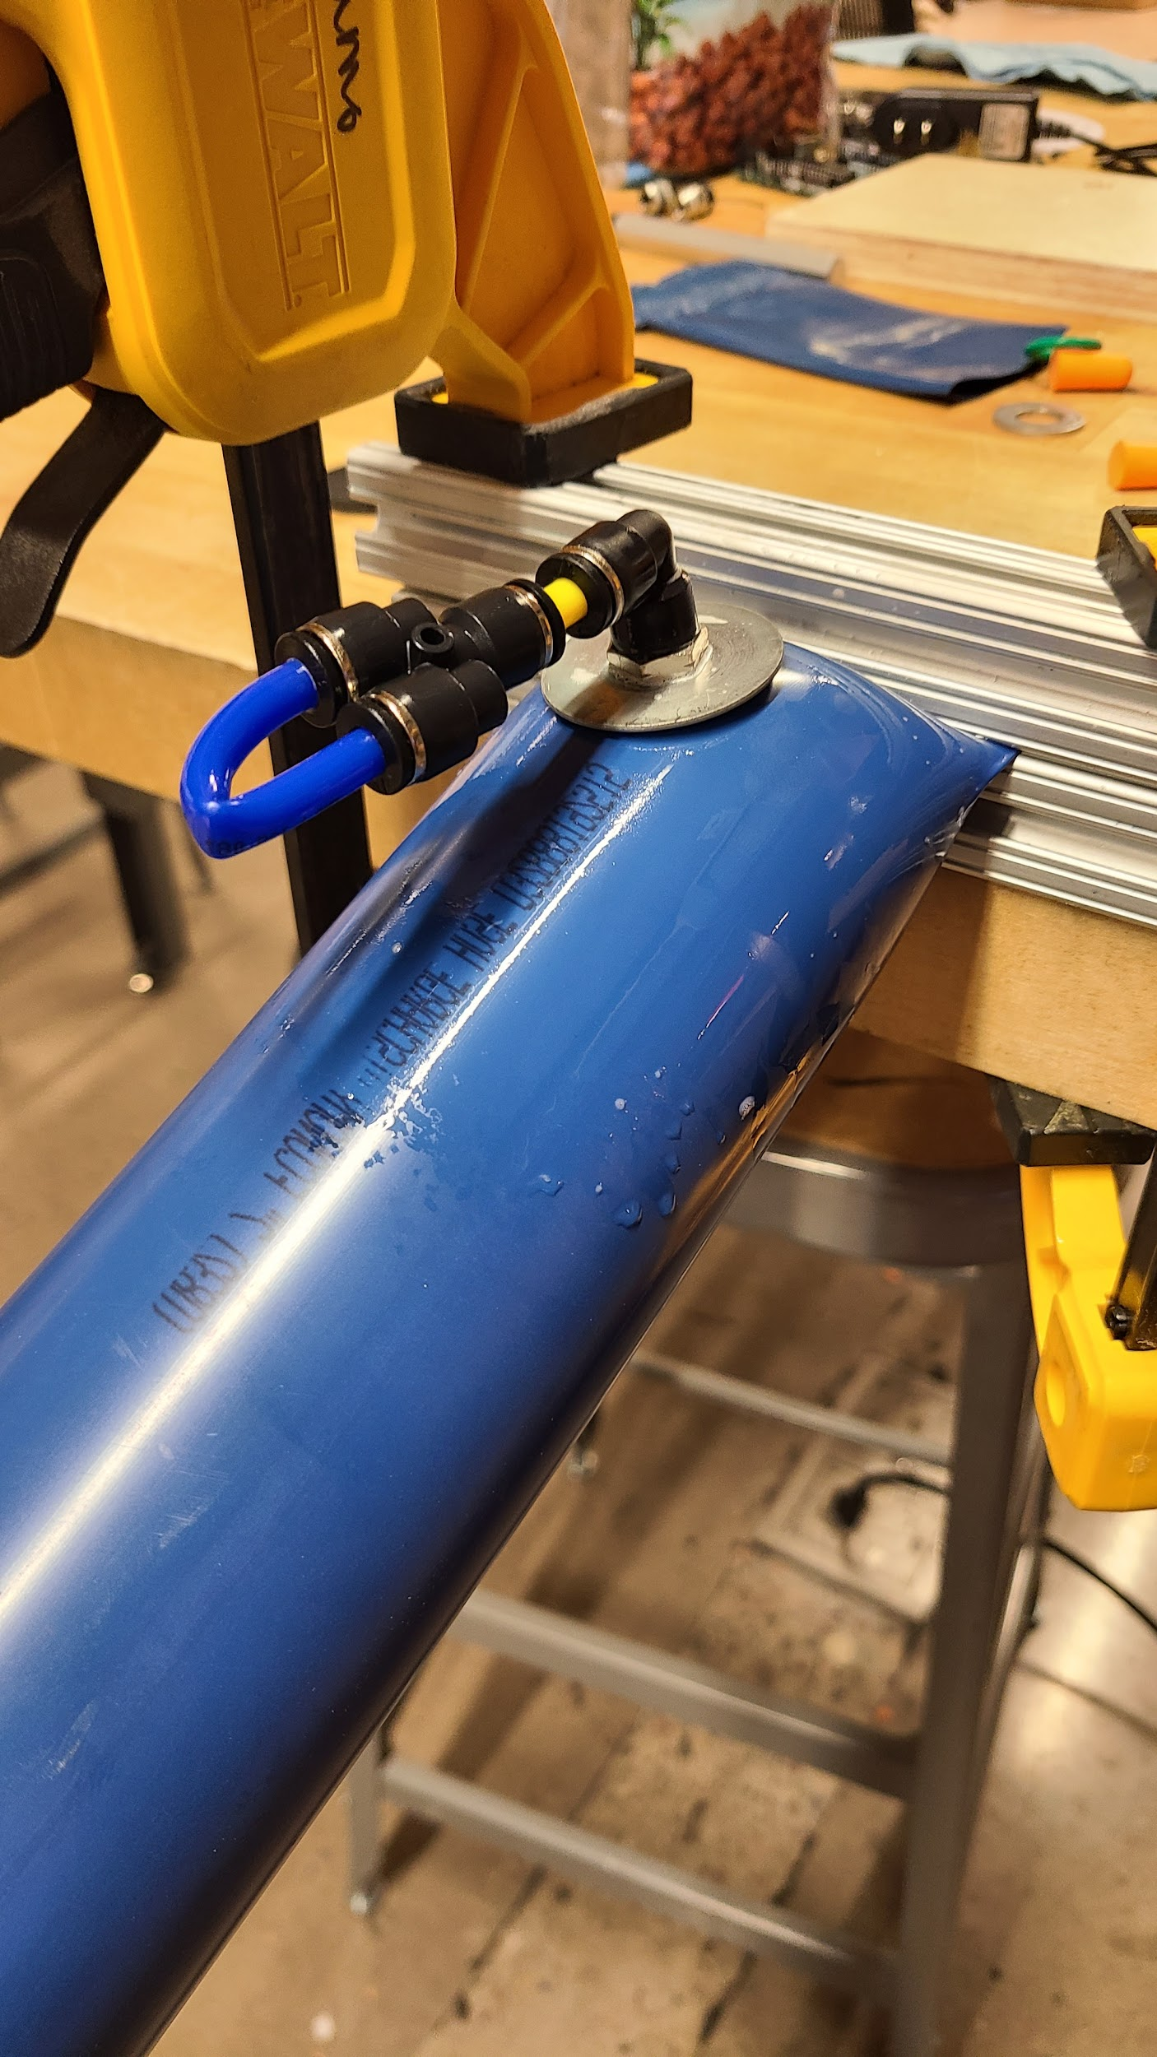
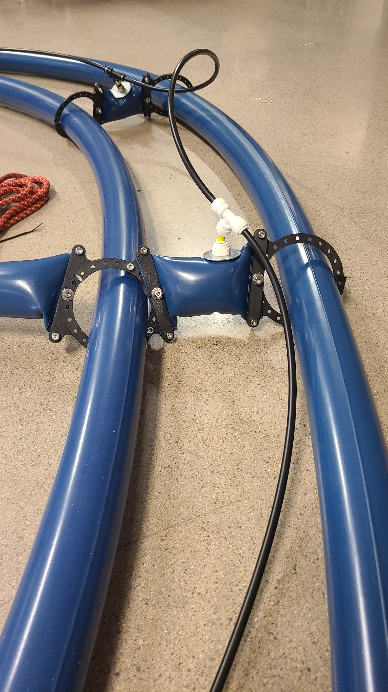
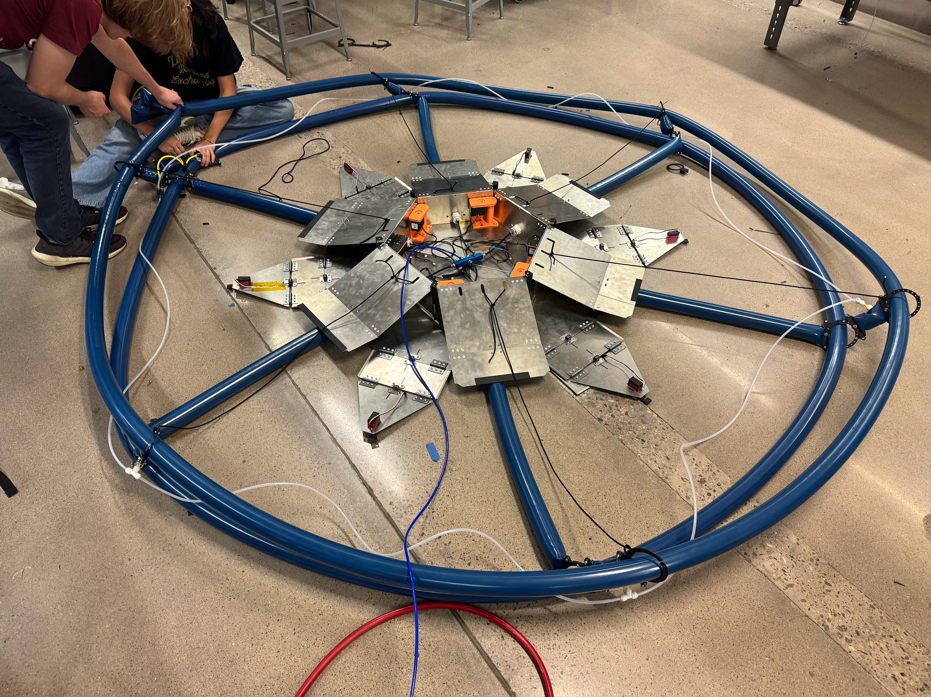
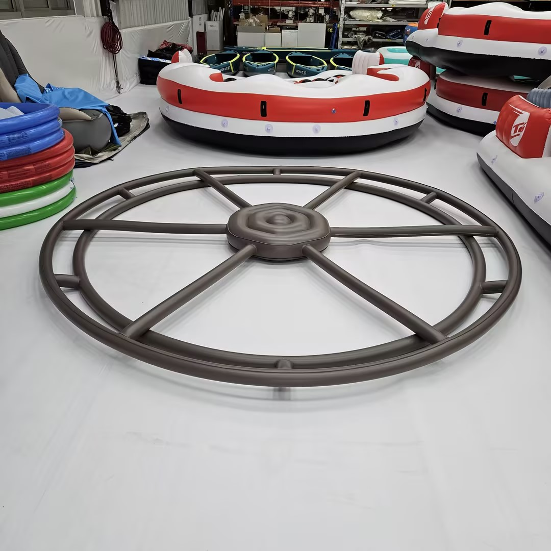
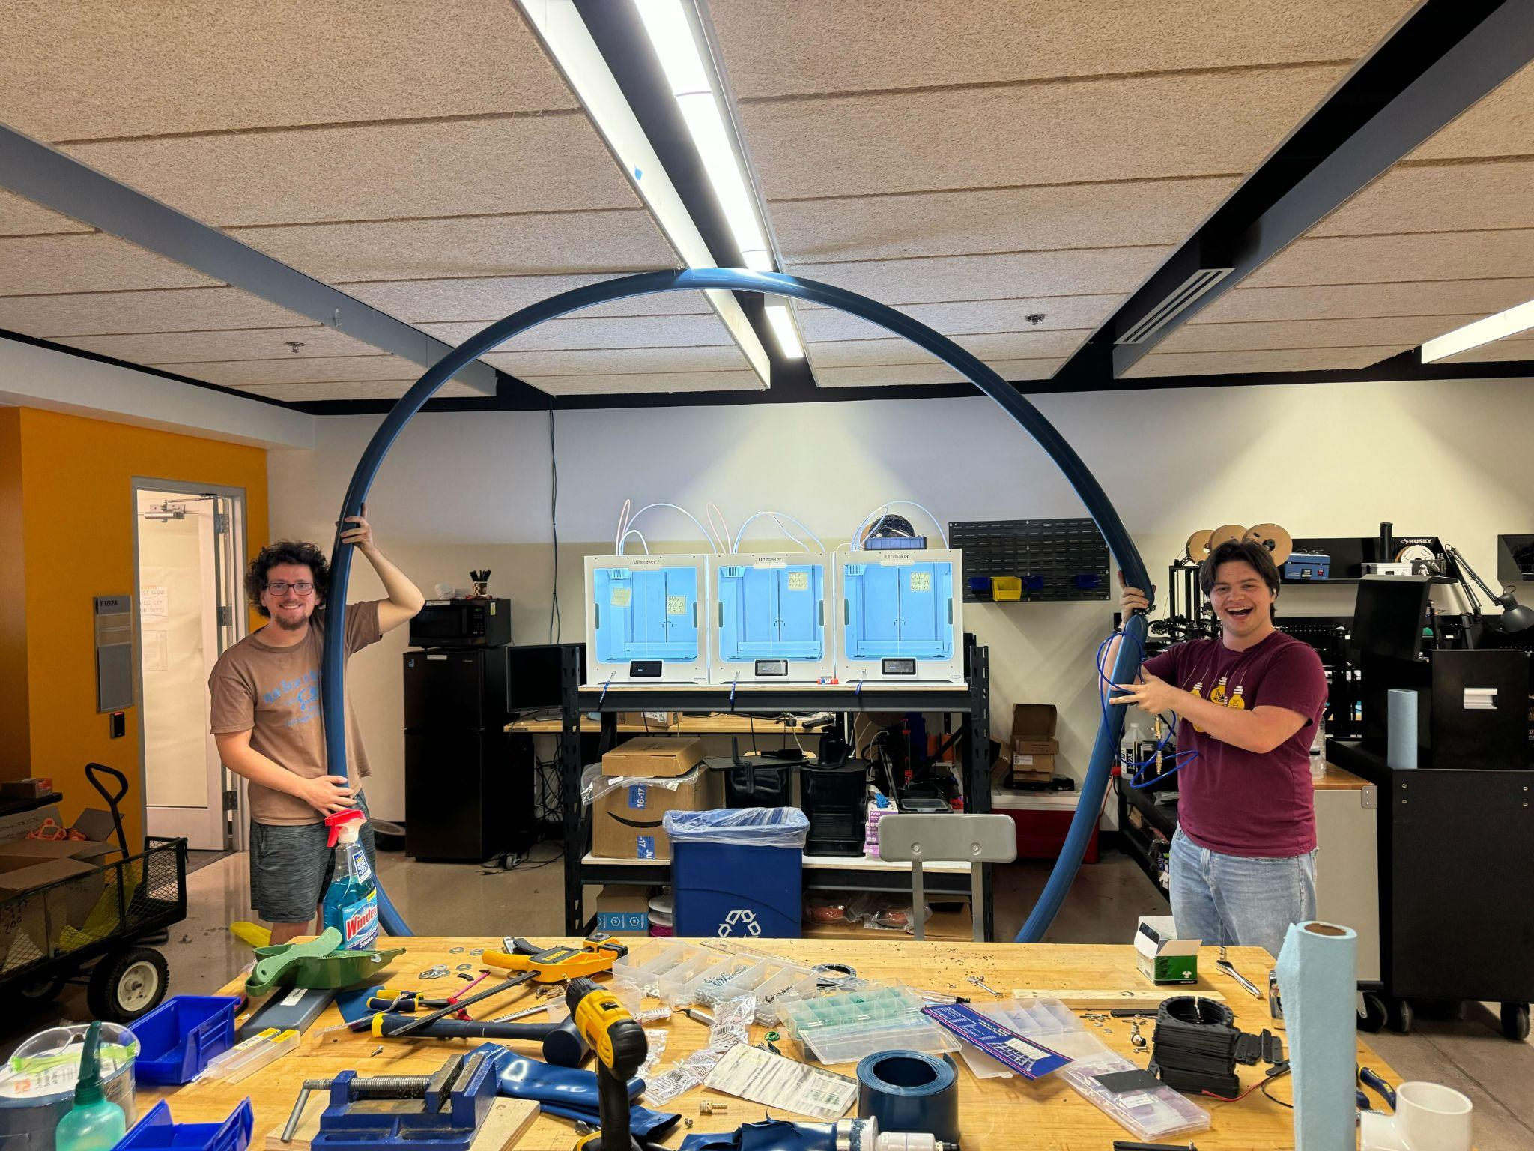
INFLATABLES
Notes:
Two inflatable systems were manufactured. The blue system was manufactured by the lab and the grey system in the lower right was manufactured by Bestway, a pool inflatable company. The blue system was manufactured due to shipping issues with the Bestway system. A brand new system was created by the lab incorporating a series of ports and mechanical clamping on the tubing. As well, ceramic string was added from the edge of the tarp to the center of the tarp to facilitate in the raising of the outer ring. Many tests were performed on test tubes to find optimal sealing techniques, port techniques, and max functional pressures of the tubing.

Slide 20
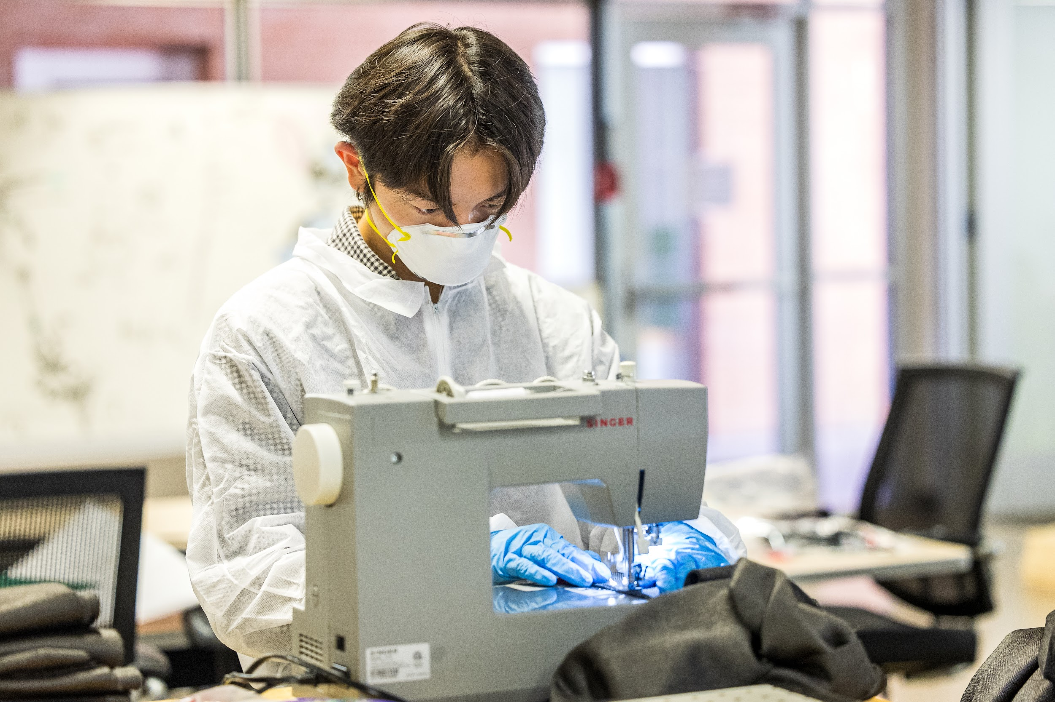
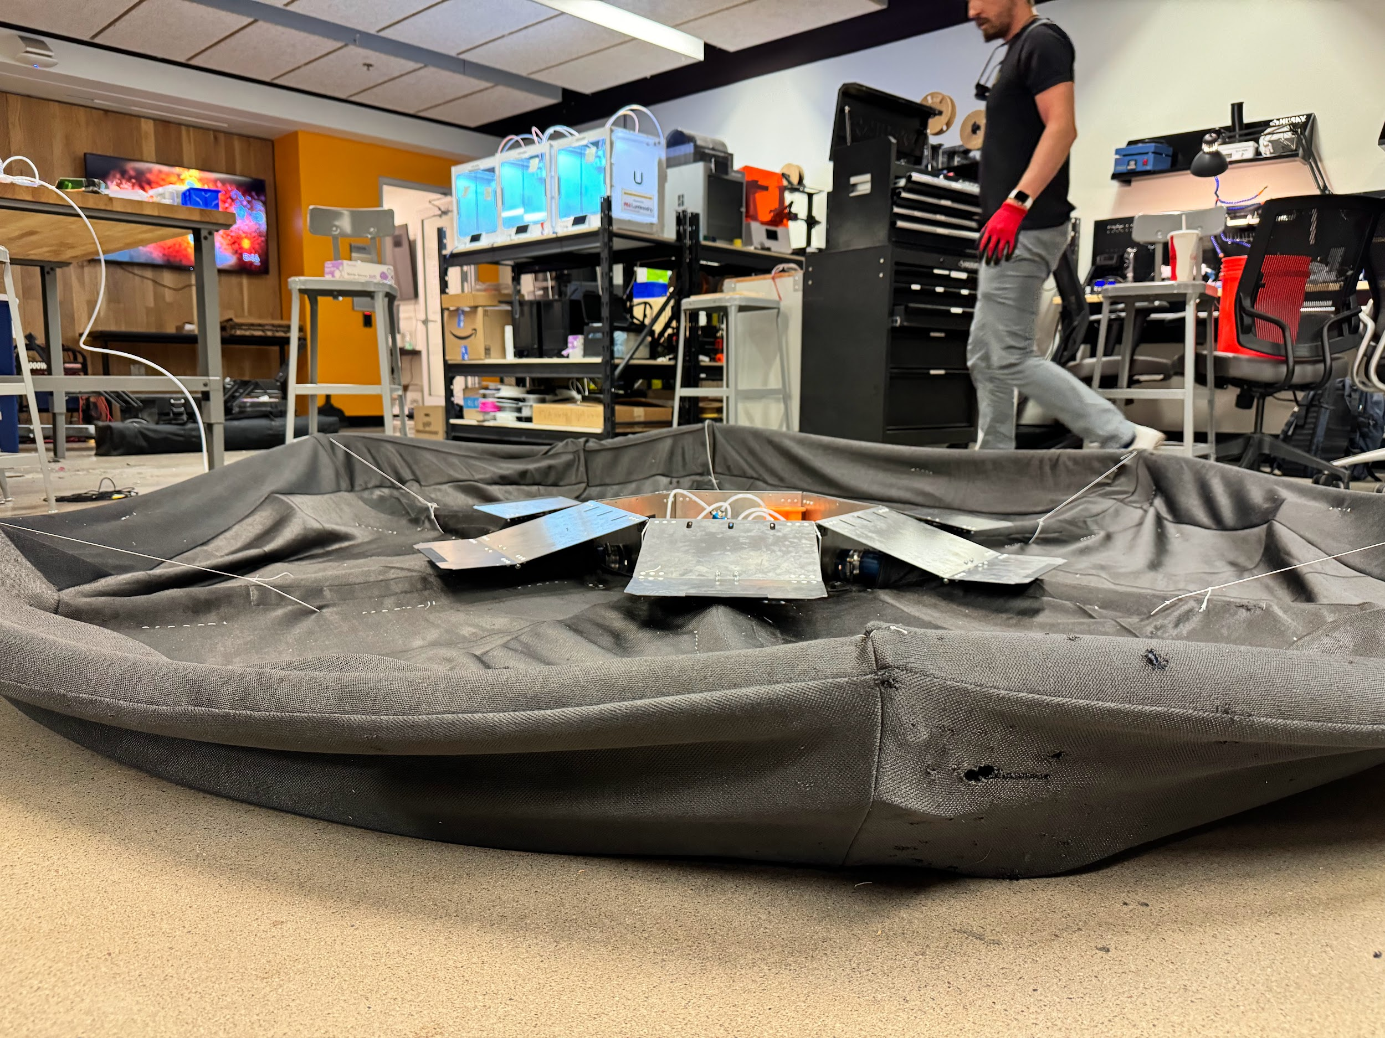
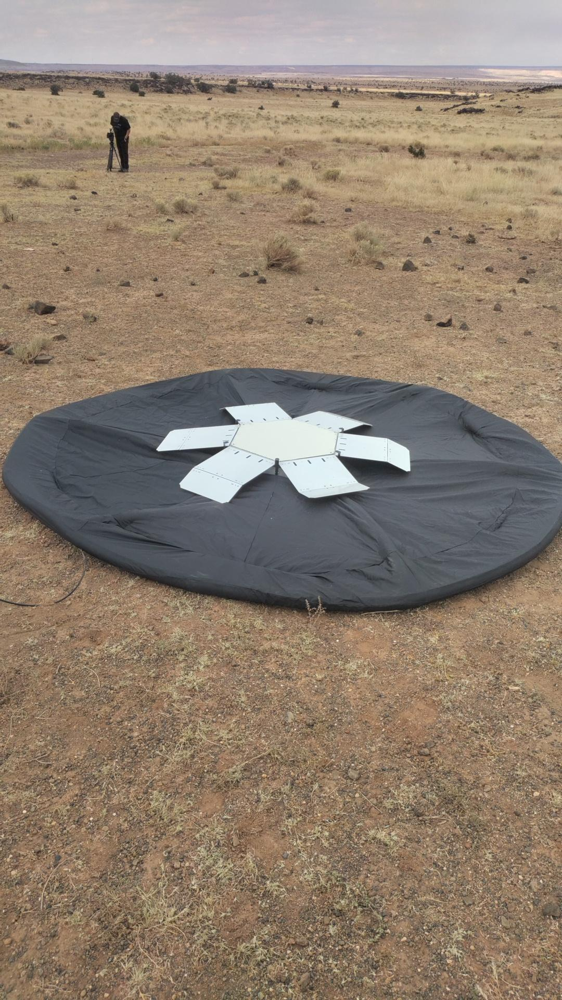
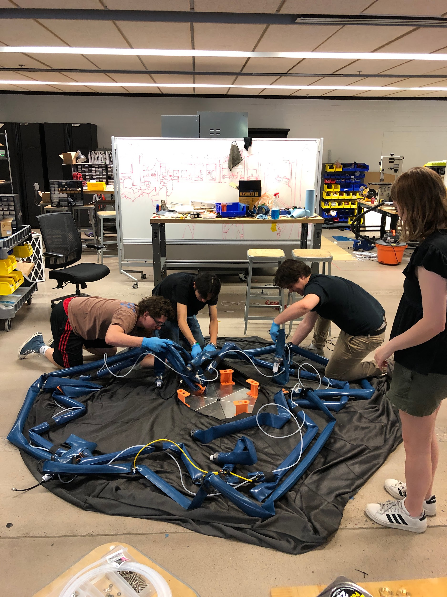
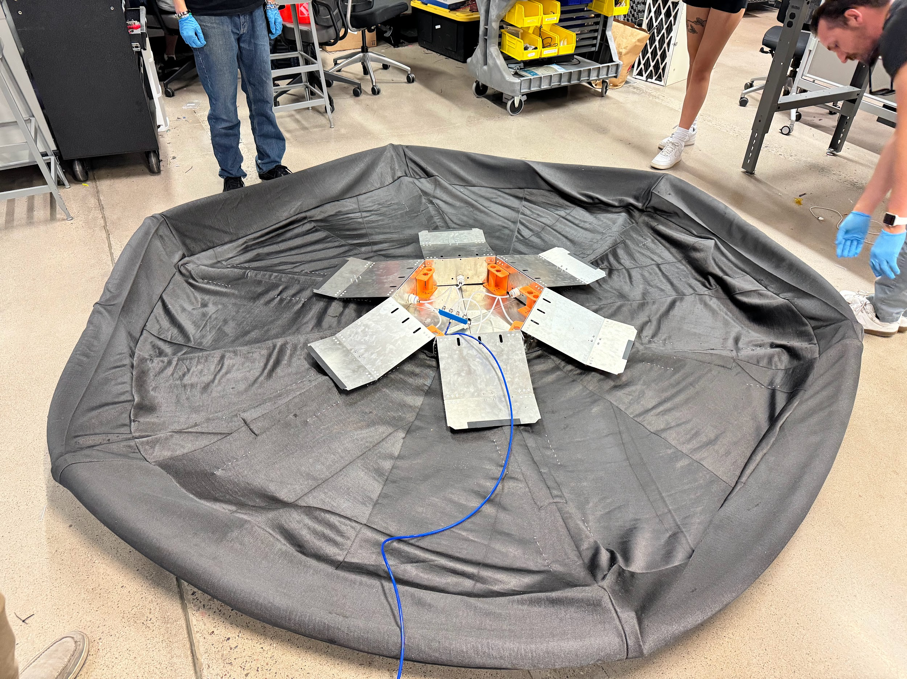
TARP
Notes:
The tarp was made from a knit carbon fiber and sewn with a high temperature ceramic thread in junction to standard thread. As well, Alumina felt with layered in the location of the beams to protect them as much as possible with the limited amount that we had available. The center housing was removed, tarp placed onto the base, and center housing replaced. Looks like a pillow case to allow for the air system to interface with the central housing.

Slide 21
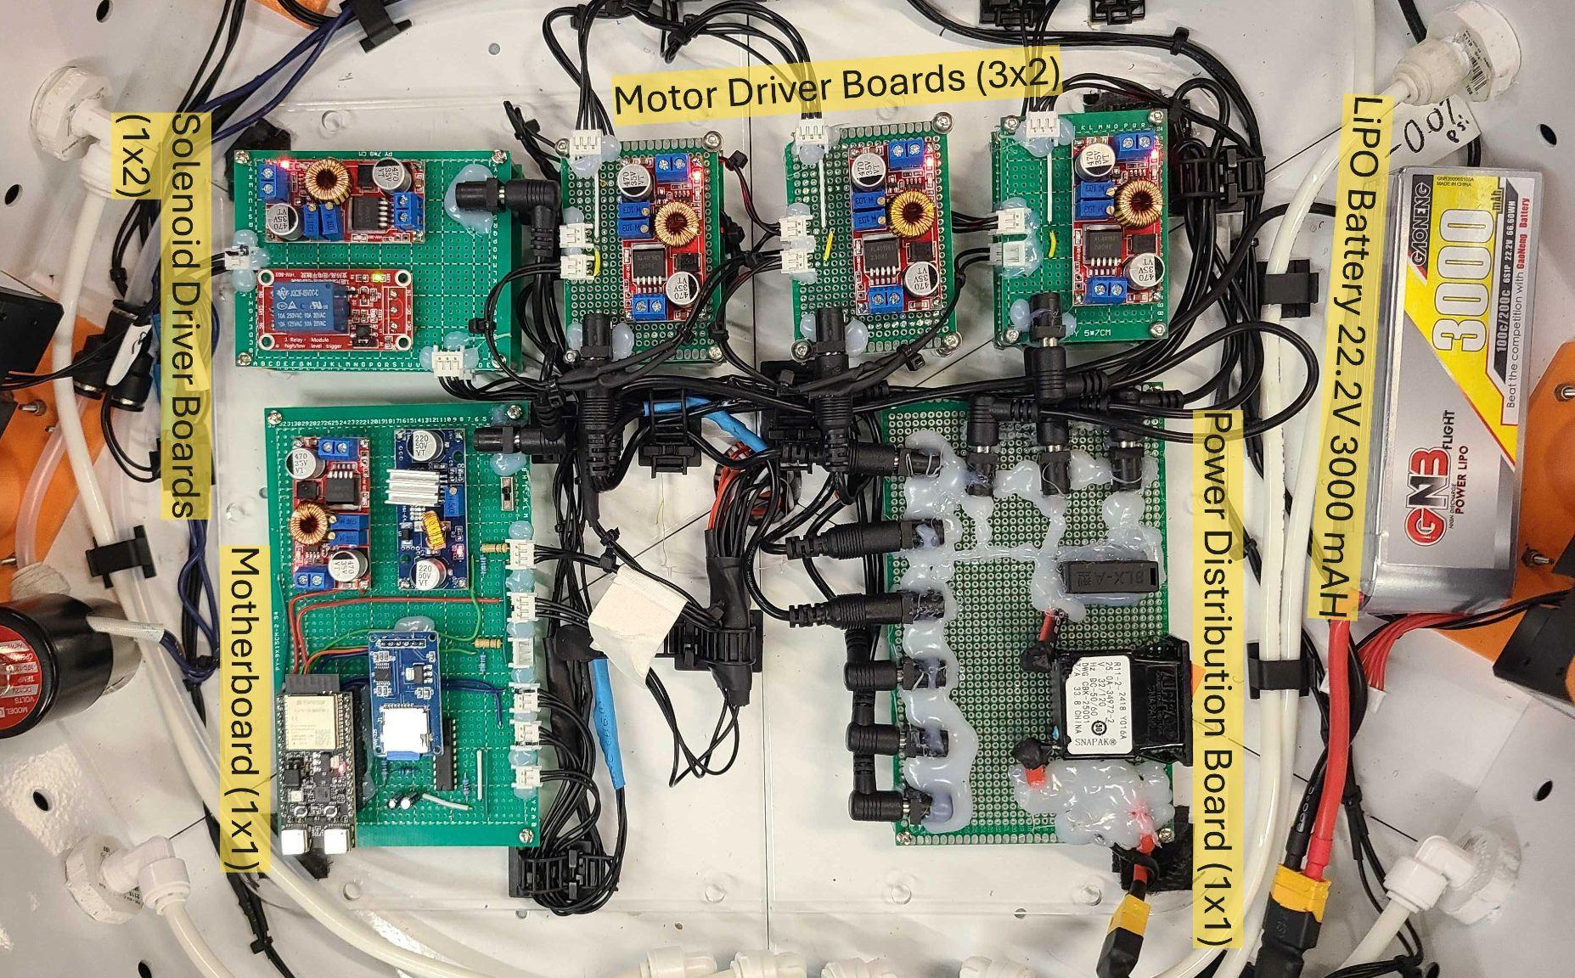
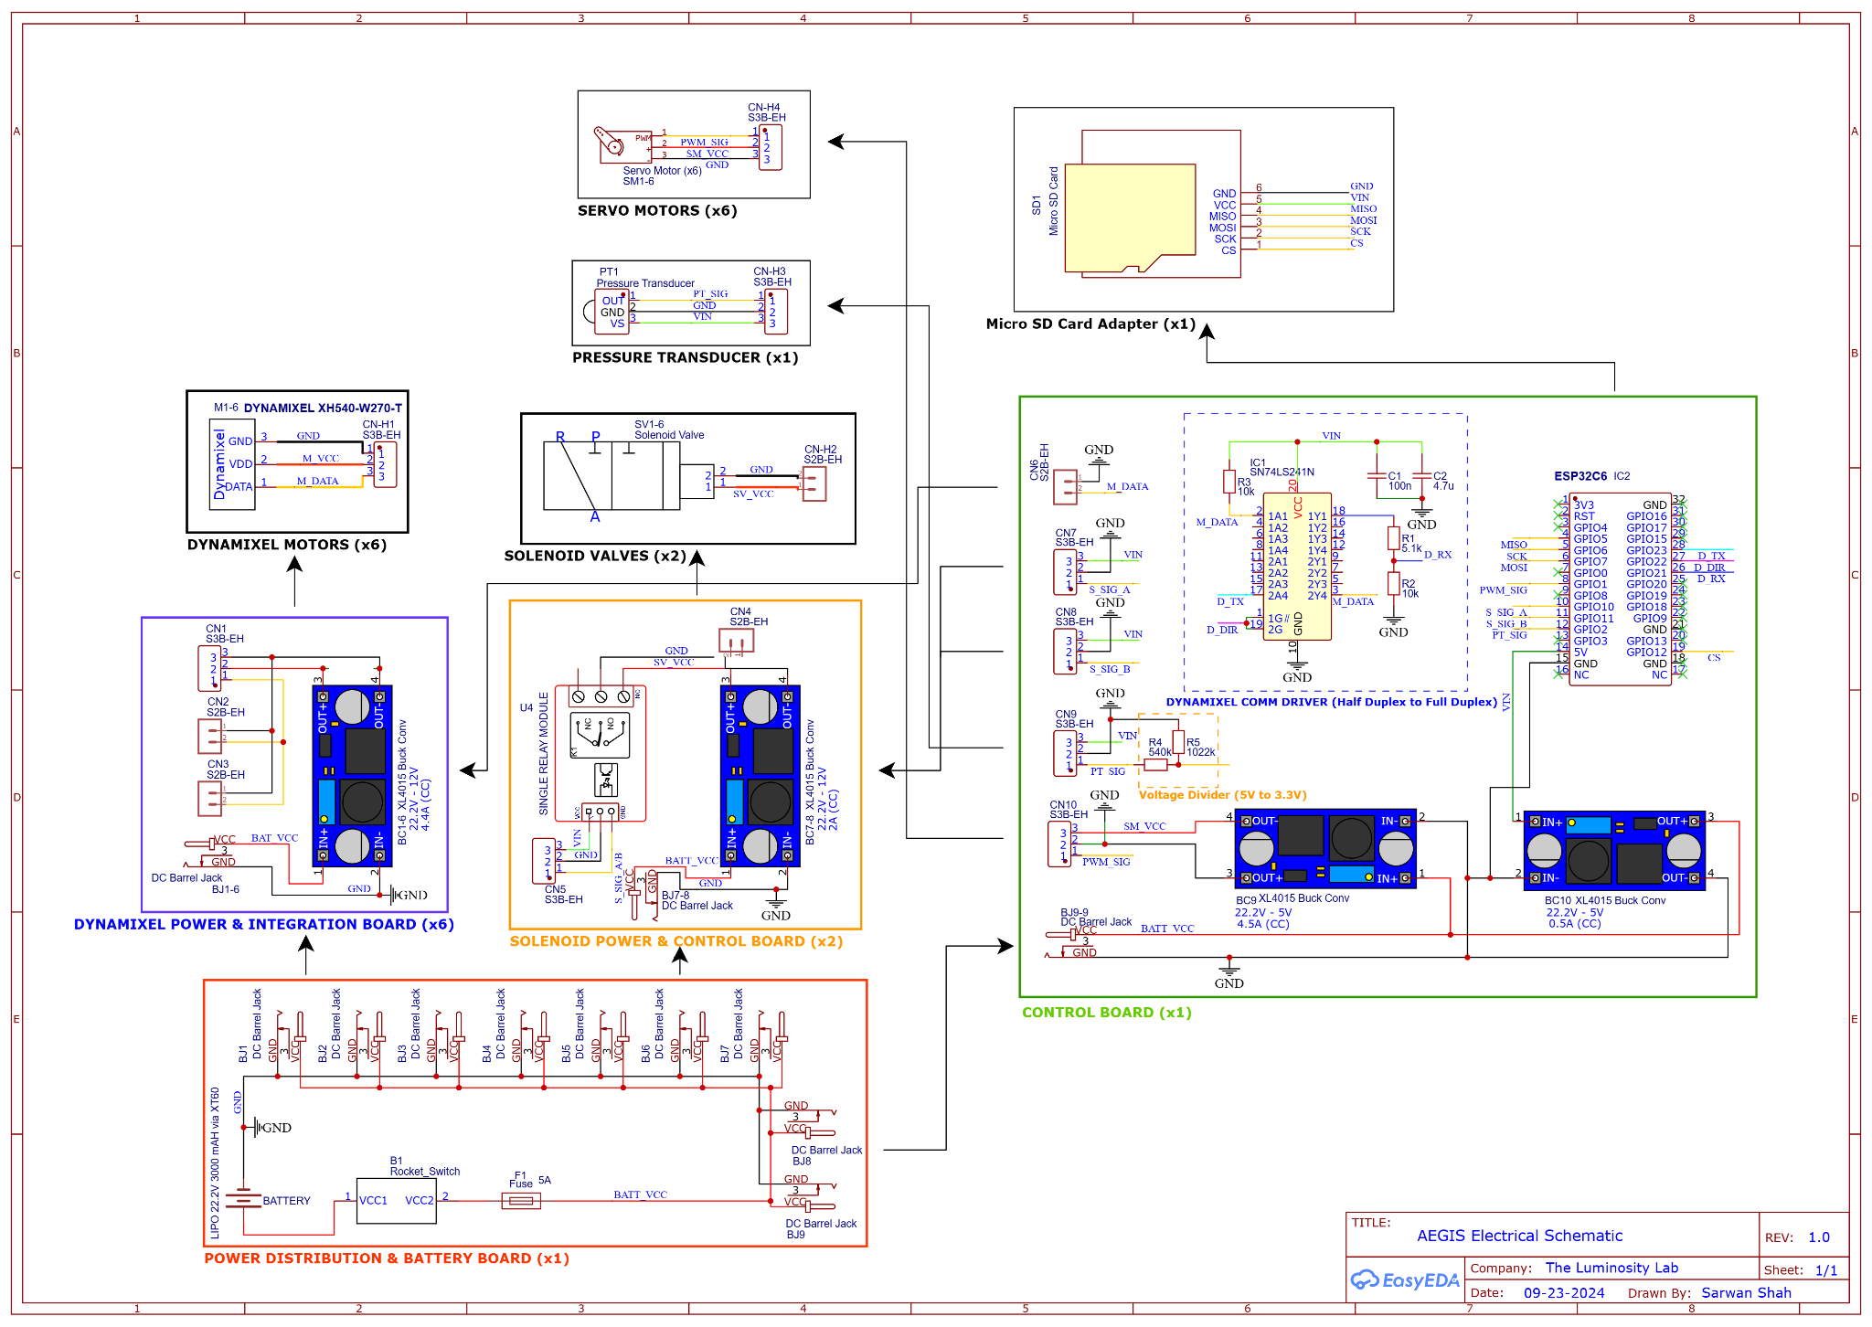
ELECTRONICS & CONTROLS
ESP32C6 controls
6 DynamixelTM motors (anchor deployment)
6 servo motors (package deployment)
2 solenoid valves (inflating and deflating)
1 pressure transducer (pressure feedback)
State machine deployment routine
Web-server as a user interface (UI) for wireless control of states
Powered via a 3000 mAH 22.2 V LiPo battery

Slide 22
RELEVANT ENVIRONMENT

Slide 23
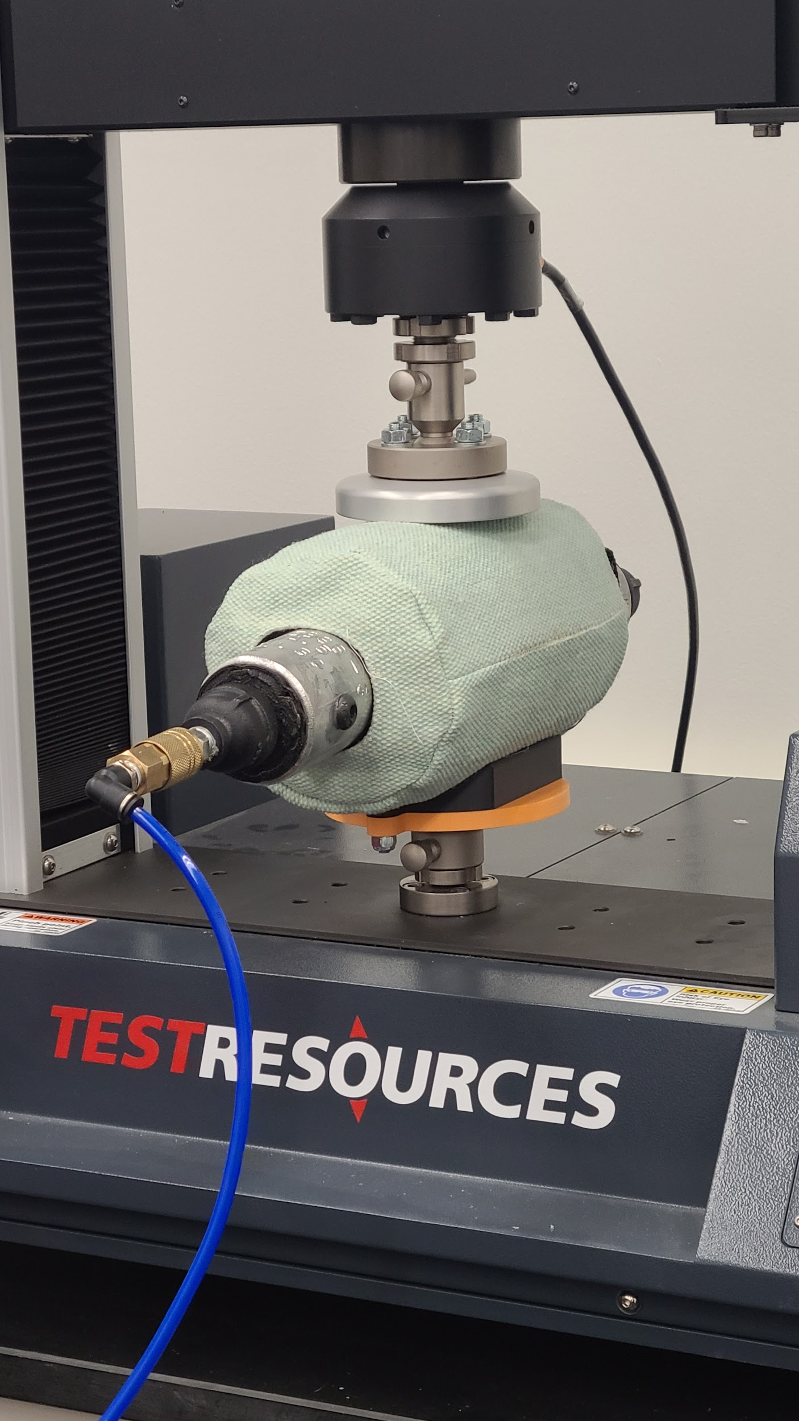
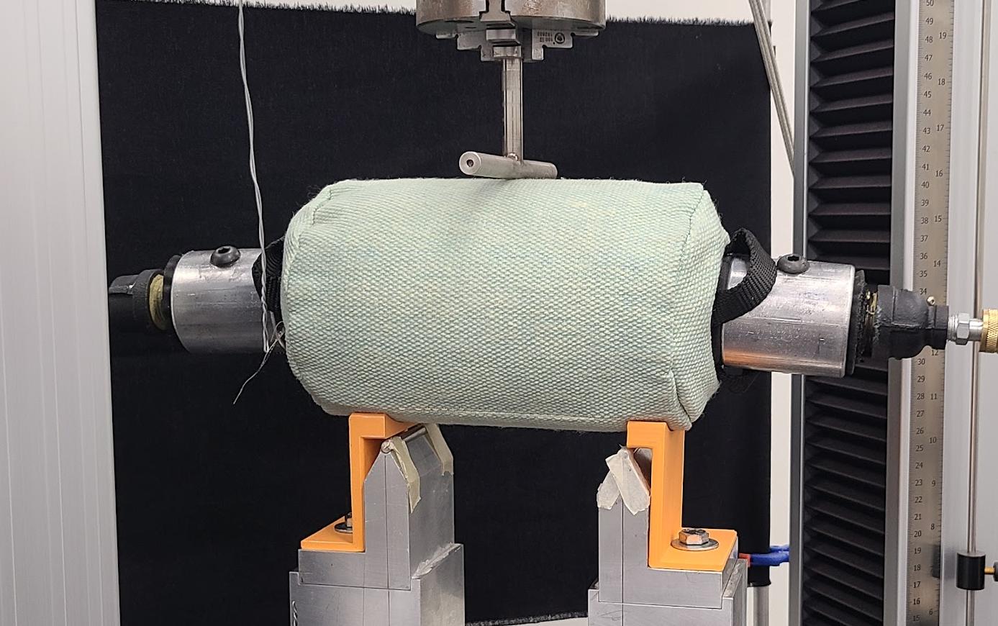

INFLATED BEAM STRUCTURAL
ASTM C365 &
ASTM D1599
Compression Testing
3-Point Bend Testing
Ballistic Nylon Encased in Kevlar
Internal Pressure: 137-172 kPa
Compressive Loading: 98 kPa
3 Point Bend Central Load: 640 N

Slide 24


TARP STRUCTURAL
ASTM D5034
Compression Mounting Plate

Slide 25





THERMAL ABLATIVE
ASTM E285-08
Tarp
Heat Shield
Uncoated
Zirconia Paint
Uncoated
Zirconia Paint
Zirconia Plasma Coating
Pre-Test
Post-Test
Ablative testing performed under Oxyacetylene torch with an argon flood

Slide 26


TARP - GAS PERMEABILITY
ASTM D737-18
Outlet Pressure Transducer
Test Article
Inlet Pressure Transducer
Flowmeter

Slide 27



TARP - ABRASION & STIFFNESS
ASTM D3885-07A &
ASTM D1388-23
2.5cm x 20cm Sewn Specimen
5” Stroke
41.5 ° Bend Indicator
22 ° Bend
Mean Time To Failure .91 meters

Slide 28



ANCHORS - PULL TEST
ASTM D3689 &
ASTM D3966
Deployment
Lateral
Vertical
Test Auger
Pulley System
Shaft
Hanging Mass Sale
Tensile Load Cell
Sheath
Anchor Style | Lateral (N) | Vertical (N)
Helical | 51.50 | 969.23
Woodscrew | 673.46 | 558.52
Ratchet Strap

Slide 29




ELECTRONICS VALIDATION
DynamixelTM motors
Position control mode
Torque: 1.98 N-m
Controlled through single channel simultaneously.
0 (Locked) to 60 (Unlocked) degrees movement.
Torque: 2.1 N-m
Bang-bang Controller
Controller frequency: 10 Hz (low frequency to avoid hysteresis)
Average deviation from setpoint within 1.7 kPa

Slide 30
EARTH ANALOG

Slide 31



ROCKET FIRE TESTING
Gas Deflection testing under a Aerotech M1419W-P solid rocket motor
1.4 kN thrust
7 second burn time
1198 degrees Celsius
Successful deflection for first 4 seconds
Friends of Amateur Rocketry, Mojave Desert, CA
Notes:
Keep pictures
Transition to the video

Slide 32






SITE SETUP AND ANALYSIS
Stuff from Kruitk’s video

Slide 33






SITE SETUP AND ANALYSIS

Slide 34


Slide 35

Deployment
76 second deployment time
Resilient to minor debris (< 5 cm)
Deployed at 4° incline

Slide 36
Path To Flight

Slide 37
TRL Advancement
[TRL 6]
[TRL 7]
[TRL 8]
2025
2028
FULL SYSTEM TESTS IN RELEVANT ENVIRONMENT
[ Communication system ]
[ Thermal control systems ]
[ Improve structural integrity ]
[ Enclosure for dust ingress ]
LUNAR ANALOG PROTOTYPE
[ Pressure vessels ]
[ Batteries ]
[ Motors ]
[ Actuators ]
[ Compute models ]
FLIGHT QUALIFICATION TESTING
[ Flight ready hardware ]
[ Qualification testing ]
[ CLPS mission tech demo ]
Notes:
After the verification testing of critical components in a relevant environment, Aegis has achieved a TRL level of 5. To continue Aegis on the path to flight, the next steps would be to do a full systems test in relevant environments. This means building a full scale model, adding in the communication system which is necessary for incoming landers to center on to Aegis, improving the structural integrity of the pad, and adding a thermal control system. To achieve TRL 7 and 8, every component in the design would be replaced with heritage or flight ready components. This includes the pressure vessels, battery, motors and actuators, and all of the electronics. This prototype could be qualified by sending it onboard a CLPS mission to the moon as a tech demonstration of deployment and lander testing. In addition to deployment testing, Aegis will need to pass TVAC testing, vibration testing, and dust ingress testing. To continue advancing Aegis along the path to flight, our team plans to use the remaining funds to work towards TRL 6. We also plan to pursue grant opportunities, such as NASA Tech-Flights to continue the mission of Aegis.

Slide 38


Slide 39
























Special Thanks
Grant Lesley
Mechanical Engineering
Elizabeth Arnold
Computer Systems Engineering
Christina Sturgeon
Mechanical Engineering
Diwitha Rajmohan
Electrical Engineering
Ellie Moran
Chemical Engineering
Eddie Ormseth
Mathematics & Computer Science
Grace Reiter
Sustainability
Kennedy Gourdine
Sustainability
Vaibhav Khanna
Mechanical Engineering
Georgia Lee
Mechanical Engineering
Connor Owens
Mechanical Engineering
Jordan Huggett
Mechanical Engineering
James Bell
Professor,
Arizona State University
James Rice
Asst Research Scientist, Arizona State University
Haley Smallwood
Industrial Design
Tokiya Aono
Fashion Design
Sarwan Shah
Electrical Engineering
Om Panchal
Aerospace Engineering
Ahmed Nasr
Electrical Engineering
Nick Nguyen
Computer Systems Engineering
Vianka Jauregui
Graphic Design
Brian Ridenour
Material Science
Benjamin Schnieper
Industrial Design
Tyler Smith
Sr. Director,
Luminosity Lab,
Arizona State University

Slide 40
References
[1] M. Wittal, J. Phillips Iii, P. Metzger, B. Link, J. Mantovani, and D. Batcheldor, “AAS 20-511 THE BEHAVIOR OF
HIGH-VELOCITY DUST GENERATED BY LANDER PLUMES IN THE LUNAR ENVIRONMENT.” Available:
https://ntrs.nasa.gov/api/citations/20205003590/downloads/20_Wittaletal_LanderPlumeEjecta.pdf
[2] Obsolete, “Apollo 11 Lunar Descent Flight Director’s Loop HD,” YouTube, Aug. 10, 2014.
https://www.youtube.com/watch?v=QKdKBILTUK4 (accessed Oct. 29, 2024).
[3] “NASA to Pick Next Generation Spacesuits for Moonwalking, Spacewalking - NASA,” NASA, May 27, 2022.
https://www.nasa.gov/news-release/nasa-to-pick-next-generation-spacesuits-for-moonwalking-spacewalking/
(accessed Oct. 29, 2024).
‌

